Slide 1
Network Analysis of Ethereum Exchanges
MA 710 – Data Mining
Presented by
Team 4
Soubhik Chakraborty, Monika Meshram, Lalitha Voruganti, Shweta Dhakare & Prachi Vadhani

Slide 2
Introduction - Blockchain
Blockchain is a shared database that stores data in blocks connected through cryptography, differing from traditional databases in its architecture.
While blockchains can store various types of data, the most prevalent use case is as a ledger for transactions.
Decentralized blockchains are immutable, meaning that once data is entered, it cannot be altered or deleted. In the case of Bitcoin, transactions are permanently recorded and publicly visible.

Slide 3
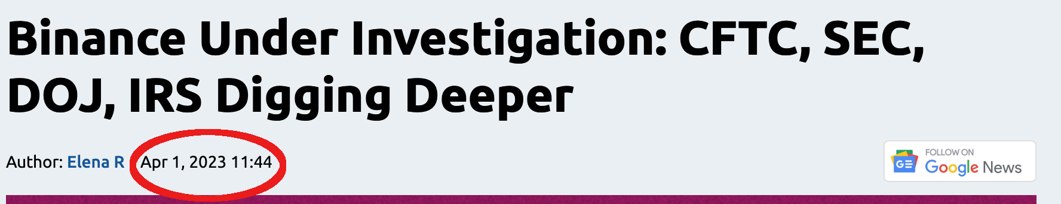
Fraud Analytics
The main goal of Anti Money Laundering (AML) efforts is to prevent criminals from concealing the profits of their unlawful activities.
Criminals use money laundering to make their illicit funds appear as though they were obtained legally.
AML regulations mandate that financial institutions establish complex customer due diligence plans that assess money laundering risks and detect suspicious transactions.

Slide 4
Data Set
Total Data Set Size is 8.3 Gigabytes comprising of
~38.9 Million Transactions having
~28 Tokens, traded by
~ 6.08 million entities, out of which
297 entities have labelled information extracted from web containing
long chains
like 0x6f259637dcd74c767781e37bc6133cd6a68aa161 has 344,426 number of transactions
Variables: Token _Address / From _Address / To_Address / Value
and few more like txn_hash, block_number, log_index
Notes:
One Instrument – 100,000 entries & 14000 edges
20 instruments – compressing the database to 22MB

Slide 5
Purpose of Our Analysis
Classify groups, and segment data to search through millions of transactions to find patterns and detect fraud
Learn suspicious-looking transactions and use those patterns to predict validity of future transactions realtime.

Slide 6
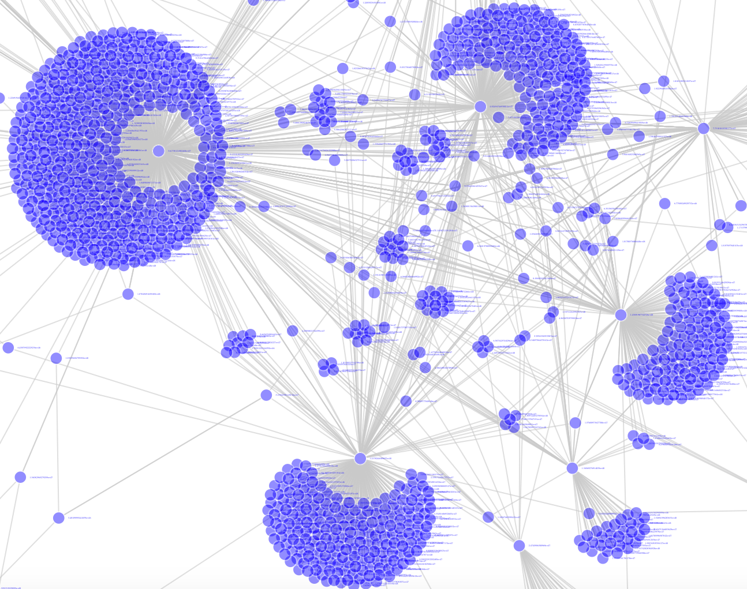
Problem Thinking
What is Fraud Detection
Unexpected transaction depending on historical pattern
Known methodologies like Wash Trading (self buying and selling to inflate volatility)
Boat account transactions (one large transaction is broken down into smaller pieces and routed through multiple accounts to the destination account)
Under or Over Valued instrument trading (financial terrorism)
Ransomware payments
Why Network Approach
Look at the overall interaction of entities instead of per transaction
Node affinity can be measured either using features of the entity, Or purely via edge features like Dyadic, Triadic or Simmelian ties
Allows integrated approach towards modelling
(a) individual transaction chains (transactions in parts) Or
(b) overall structural hotspots (across transactions as a whole - exchanges) via constructs like multigraphs
Notes:
Idea is to find ”circling of money”, “multi step circular trading of an instrument” etc.

Slide 7

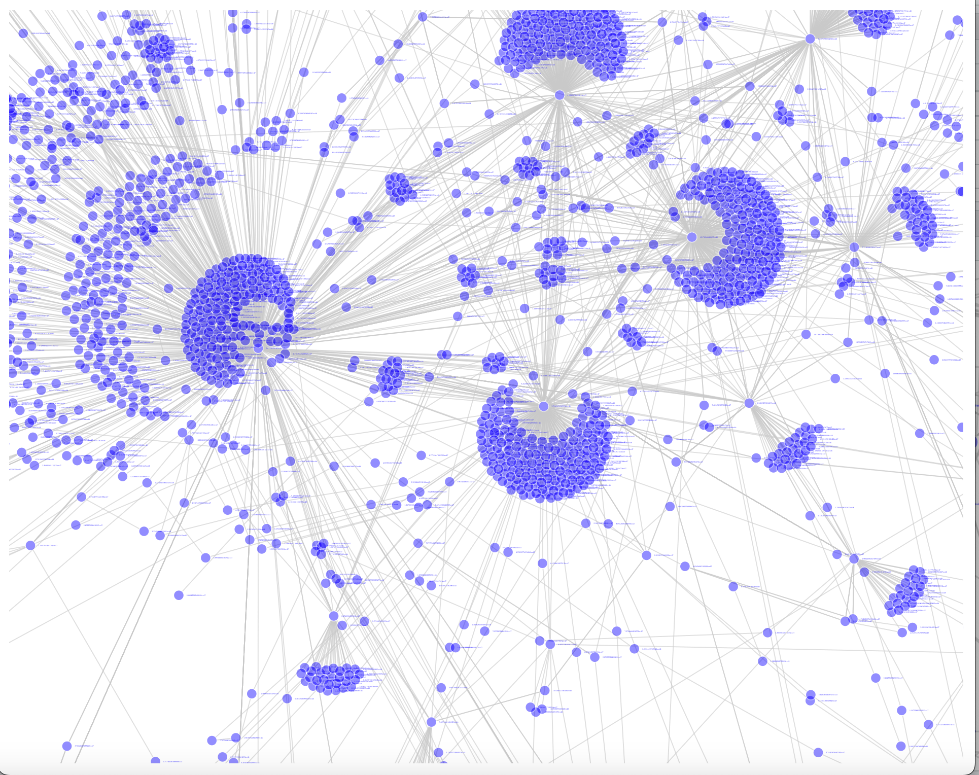
Sampling
Why trimming first instead of sampling?
Basic operations are computationally prohibitive
28 tokens to 31million transactions offers good choice of ‘Top N’ transactions for large ’N’.
Approach A
Choose the largest component out of a network formed with 50k transactions.
Offers intuitive explanation of the model strength corresponding to biggest conglomerate of isolated transaction of the whole network.
Approach B
Simple Random Sampling of 120K or more transactions
It will be shown later, it is hard to retain the shape of the overall network using random sampling.
Screenshot of Interactive Plot from just 10k transactions
Notes:
Monika
Analytics @ Scale:
Laptop Configuration: 16 Gb memory, 8 core integrated M1 CPU, ~500mbps solid state drive
- 8GB File couldn’t be opened
1.3 GB (5milliion txn) couldn’t create a network object (OOM)
500 MB (120k txns) couldn’t determine a single network summary (degree function did not return after 30 minutes)
Finally settled with first 50,000 transactions (bootnet, sample etc. functions all could not be applied otherwise)
Right hand side universe diagram is from merely 10K transactions

Slide 8
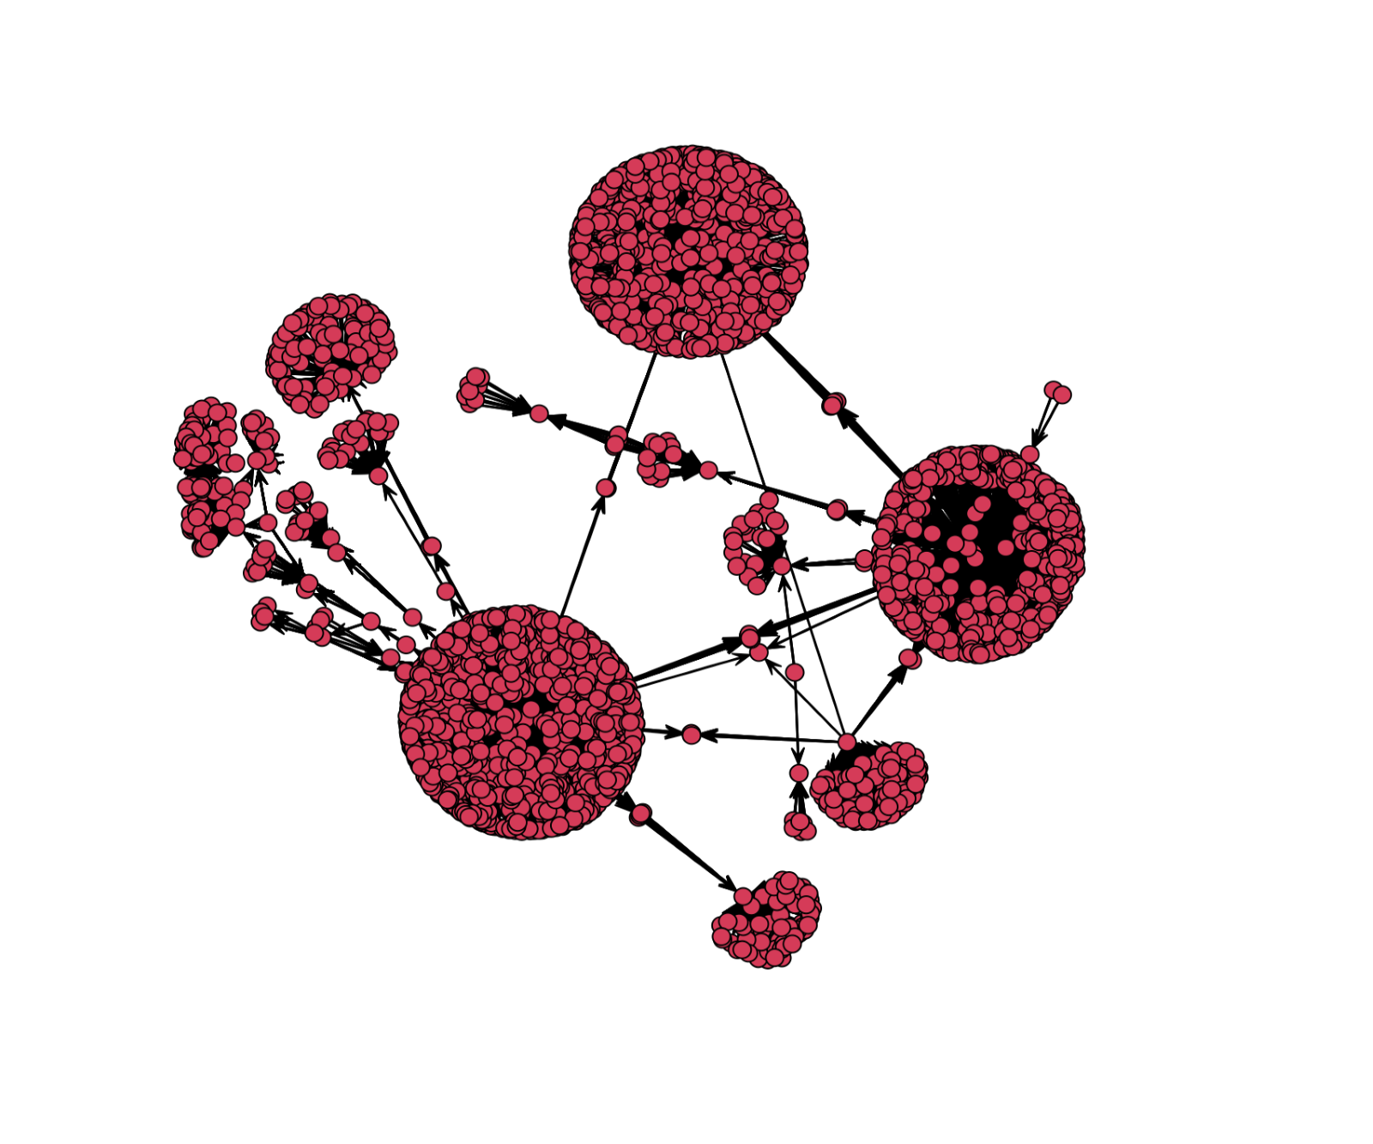
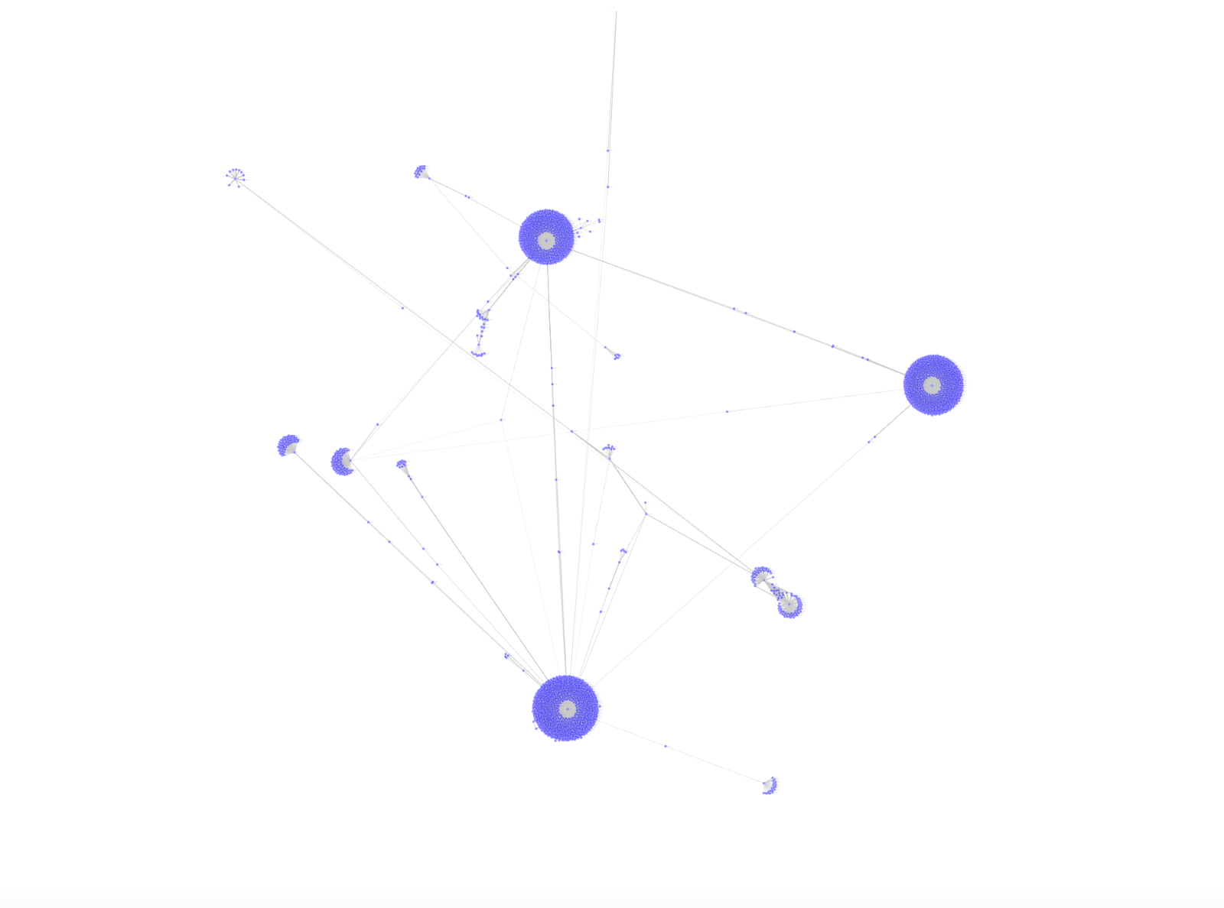
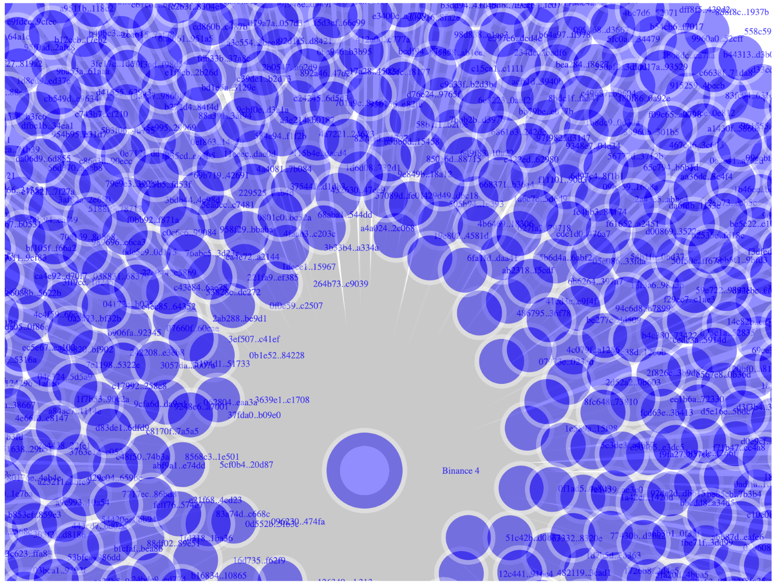
Approach A – Largest Component
Largest Component of first 50,000 transactions
Zoomed out view of the largest component
Notes:
Orange Graph -- Left:
This is a directed graph and uses transaction value for edge thickness, in other words, it's showing the direction and relative strength of money flowing between entities across multiple instruments.
A more pointy per transaction based modeling can also be done to validate online transaction realtime.
In our current scope, we are trying to evaluate the nature of the transactions happening b/w exchanges.
Right:
4. Inspect overall "highest activity" (largest component) chain of transaction.
The satellite cluster seems curious?
Left (on Click):
Zooming into one of the cluster, we see Binance as the Centralized Exchange transacting with many entities.

Slide 9
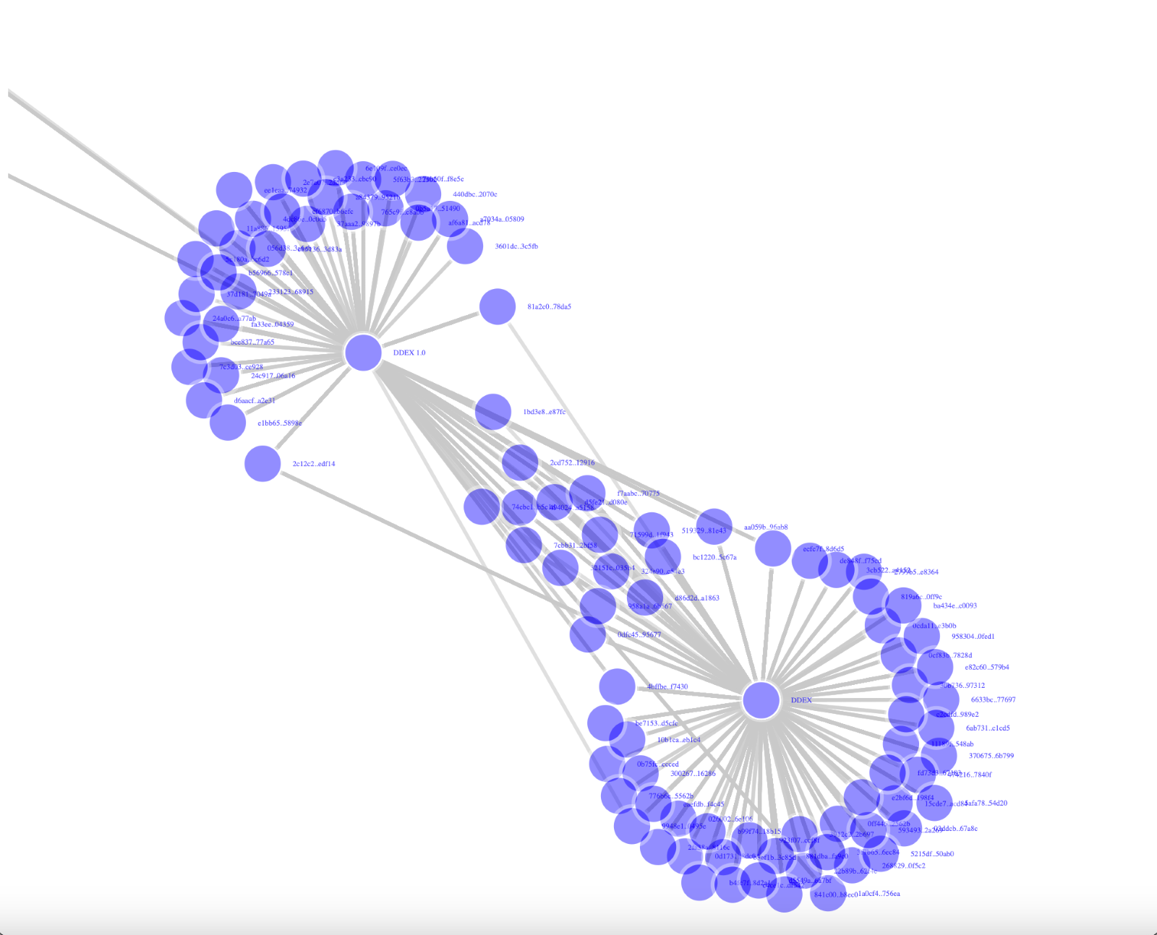
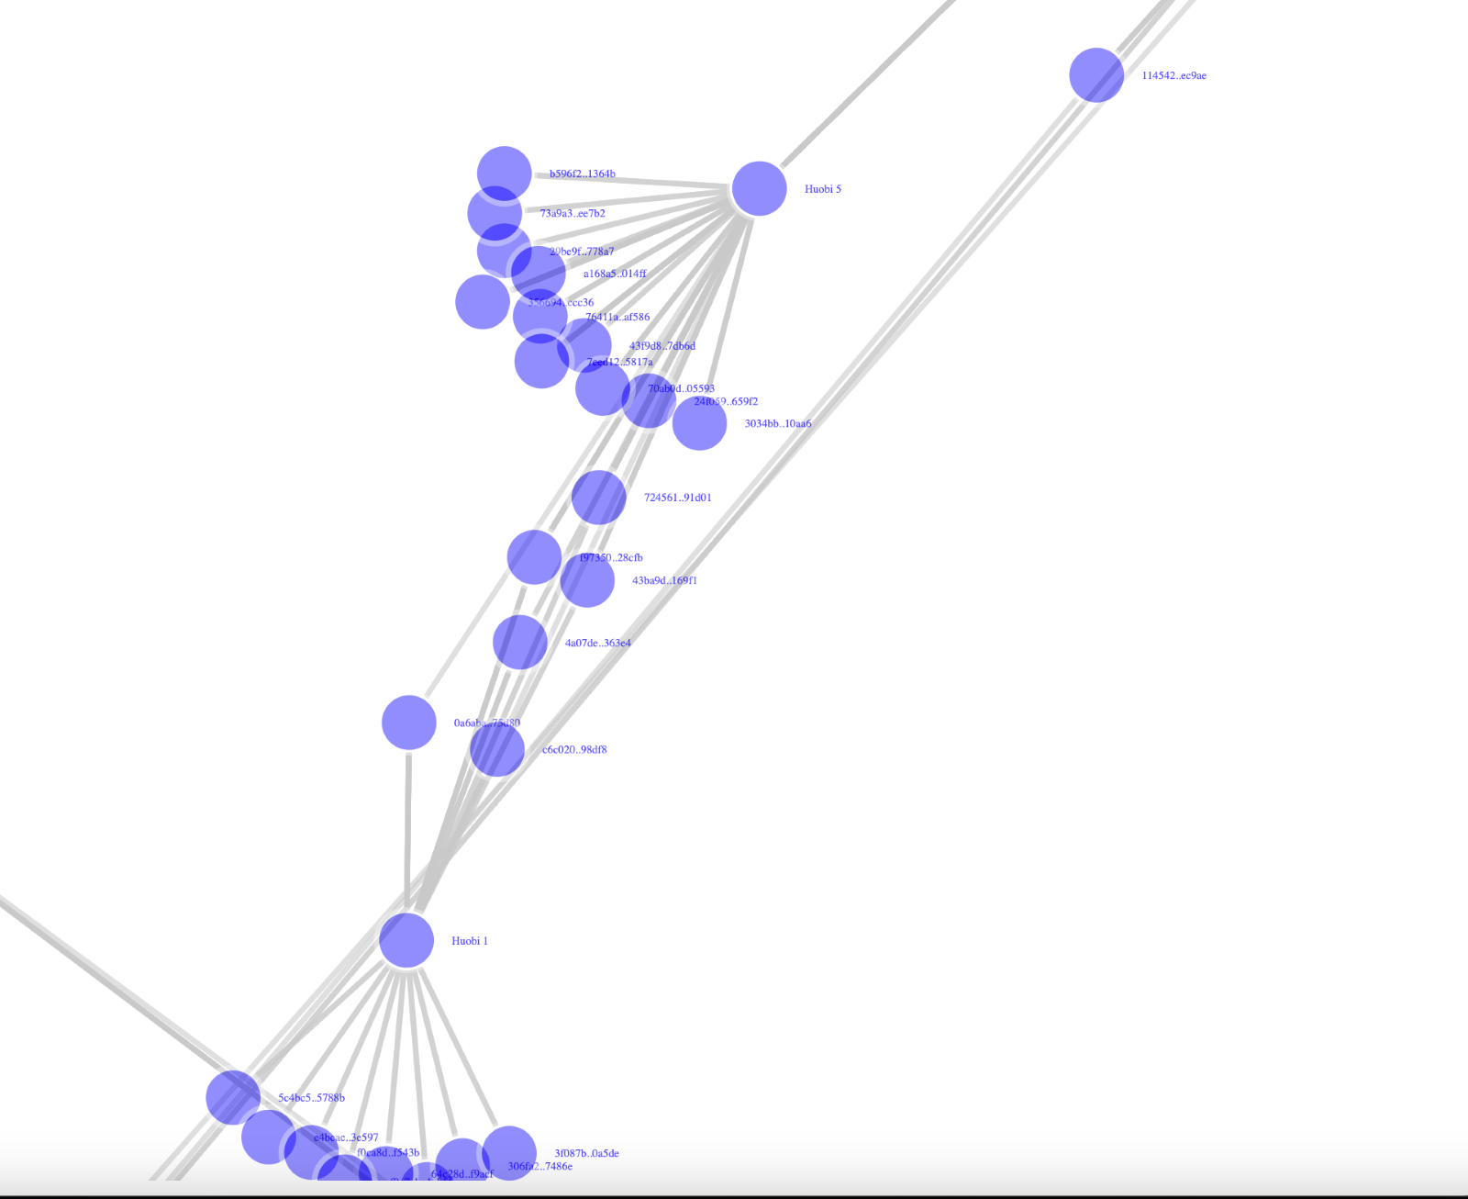
Manual Tracking of Money
Suspect Transaction
Good Transaction
Notes:
Monica
Though it is difficult to assess visually, left hand is DDEX and right one is Houbi (behaves more like Paradex)
Both exchanges looks similar interaction patterns but
Left:
Decentralized exchange closed loop transactions.
In Network terminology, network loops (dyadic relation) and homophily of the nodes.
Right:
Lot of local activity like in previous slide too, but less outflow of money i.e., lesser "assortativity".
Remember this is directed graph.
It will be clearer later how Binance, DDEX and Paradex exchanges have good or suspicious transactions.

Slide 10
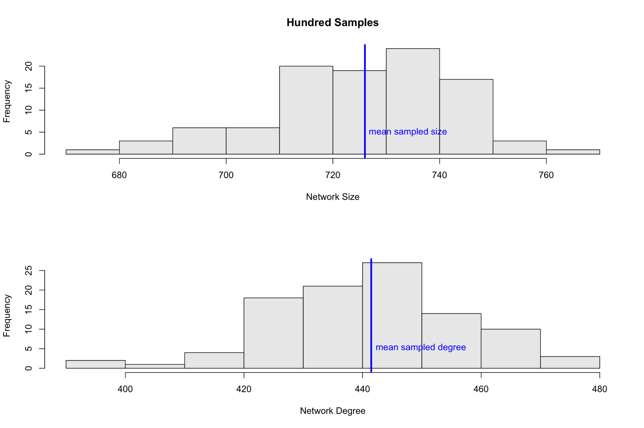
Approach B
Random Sample
10% Random sample ​
Size & Degree
Notes:
Proof of sampling (approach B):
-- Loosing the shape of the network
– and the model doesn’t converges
-- deleting the edges or vertices both creates loss of n/w
Hundred times 10% sampling of the 5 million transactions shows
- we nearly retain the network size distribution and degree characteristics (or atleast what’s the most we could attain)
The CLT tendencies of the network size and average "maximum degree" of the sampled network are retained around 740 and 400 compared to original network size of 14,405 and maximum degree 0.00024098
(way off w.r.t. to the population)

Slide 11
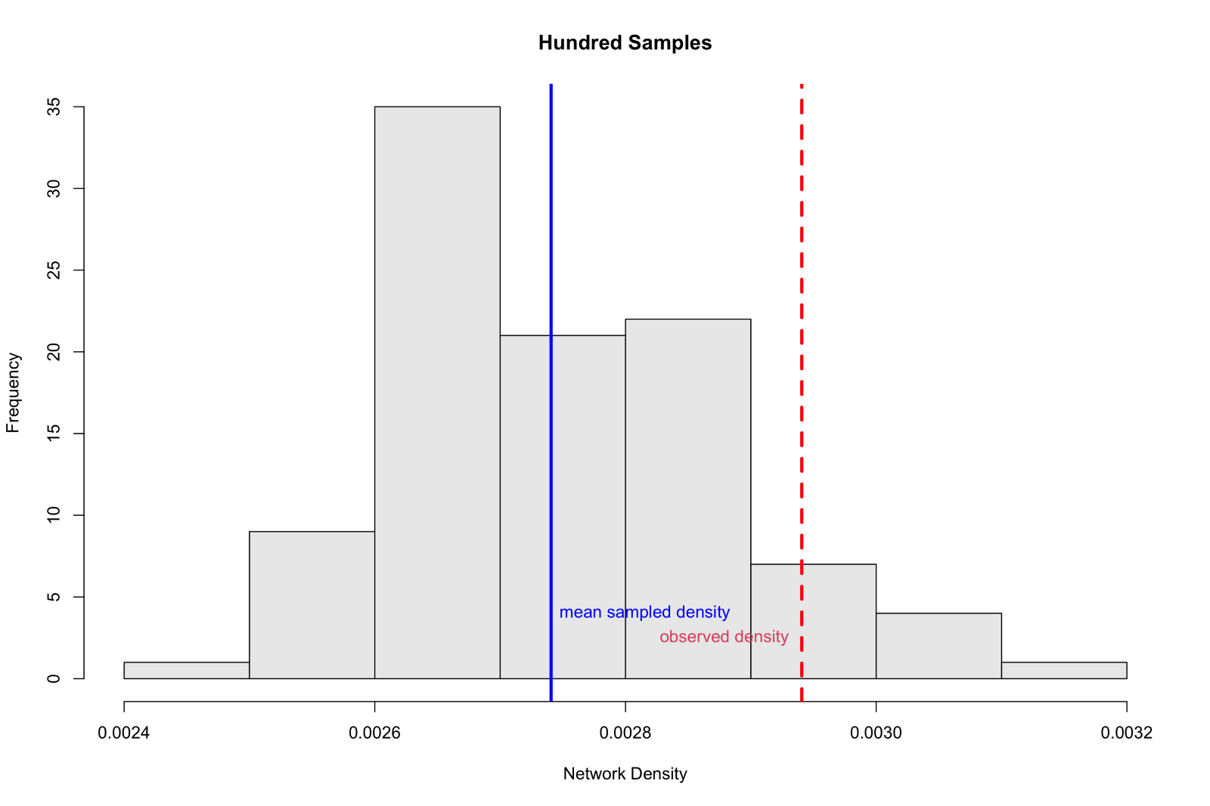
Density
Notes:
Monica
The red line is density from 120k transactions representative towards sample density being way off from the population.
Sudden drop in density of the n/w due to sampling

Slide 12
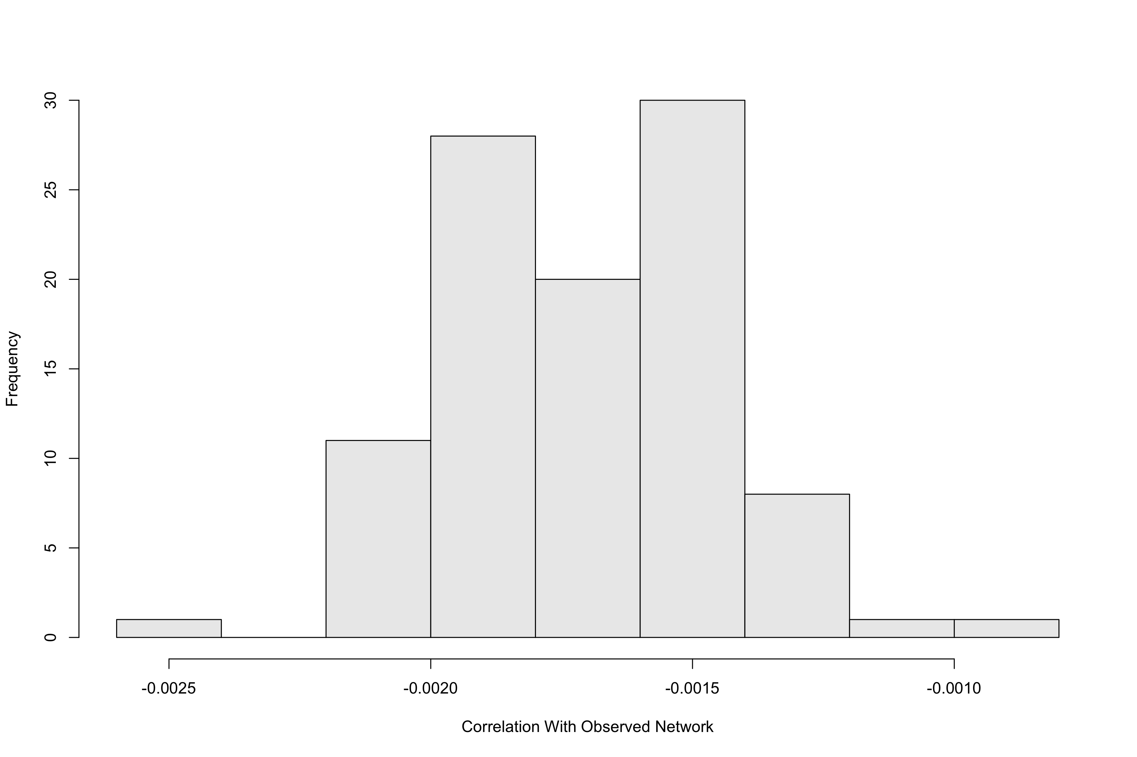
Correlation with other networks
Notes:
Monica
Samples retain the correlation

Slide 13
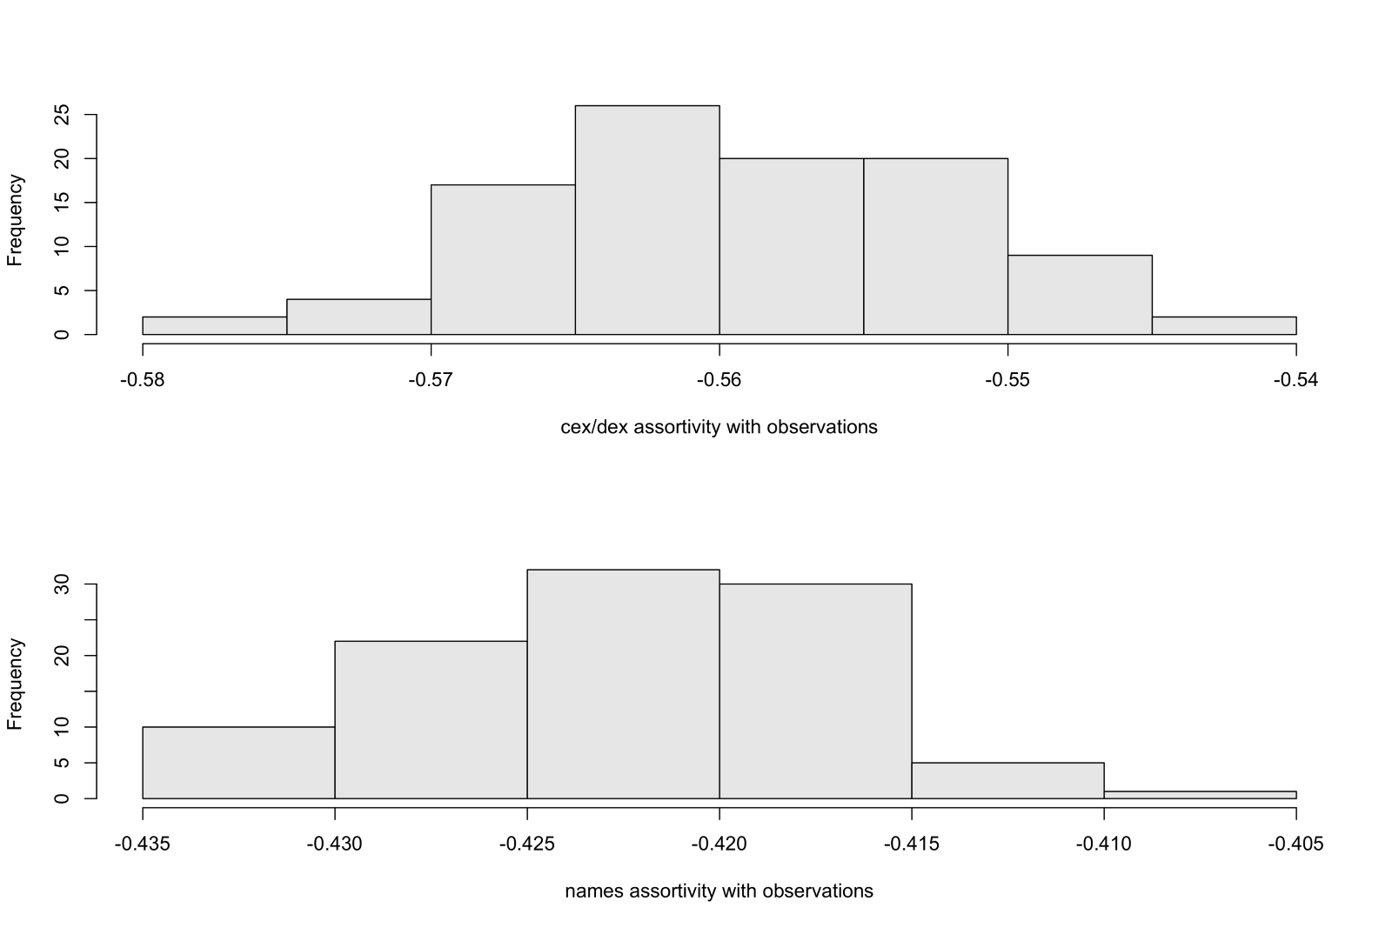
Assortativity
Notes:
Monica
Assortativity of exchange types and exchange name association is retained.

Slide 14
EDA before modeling
Power Law
Density
Clustering coefficient
Degree distribution
Diameter
Notes:
Monica
Sampling by, both, removing edges or removing vertices, the choice of model did not converge (due to either too much compute intensive, or flattened series during iteration thus leading to infinity).
Second choice was to pick the largest component from within the sample, but the model did not converge due to too small sample size or sparse network.
Final Choice of modeling ...
Approach A, determine largest component out of 5million node network – could not finish in 8hrs.
Looking at the still demanding computation, further trimming (not random sampling as we saw above, doesn't retains the shape) was required.
Approach A.1 <- Pick one token_address and focus on its chain.
Approach A.2 <- Simply pick top 50,000 rows, just like first 5 million rows were picked.
For our interest of overall modeling, approach A.1 is too specialized towards "deep analysis" of an arbitrary long chained single instrument.
Thus, taking approach A.2 , first 50,000 edges were assumed our primary dataset and because it is still disconnected, we picked the largest component .
Largest cluster has network size 2799, density 0.0046482 with maximum degree 15351 --
Rest of the network statistics will be on this 50,000 trimmed dataset.

Slide 15
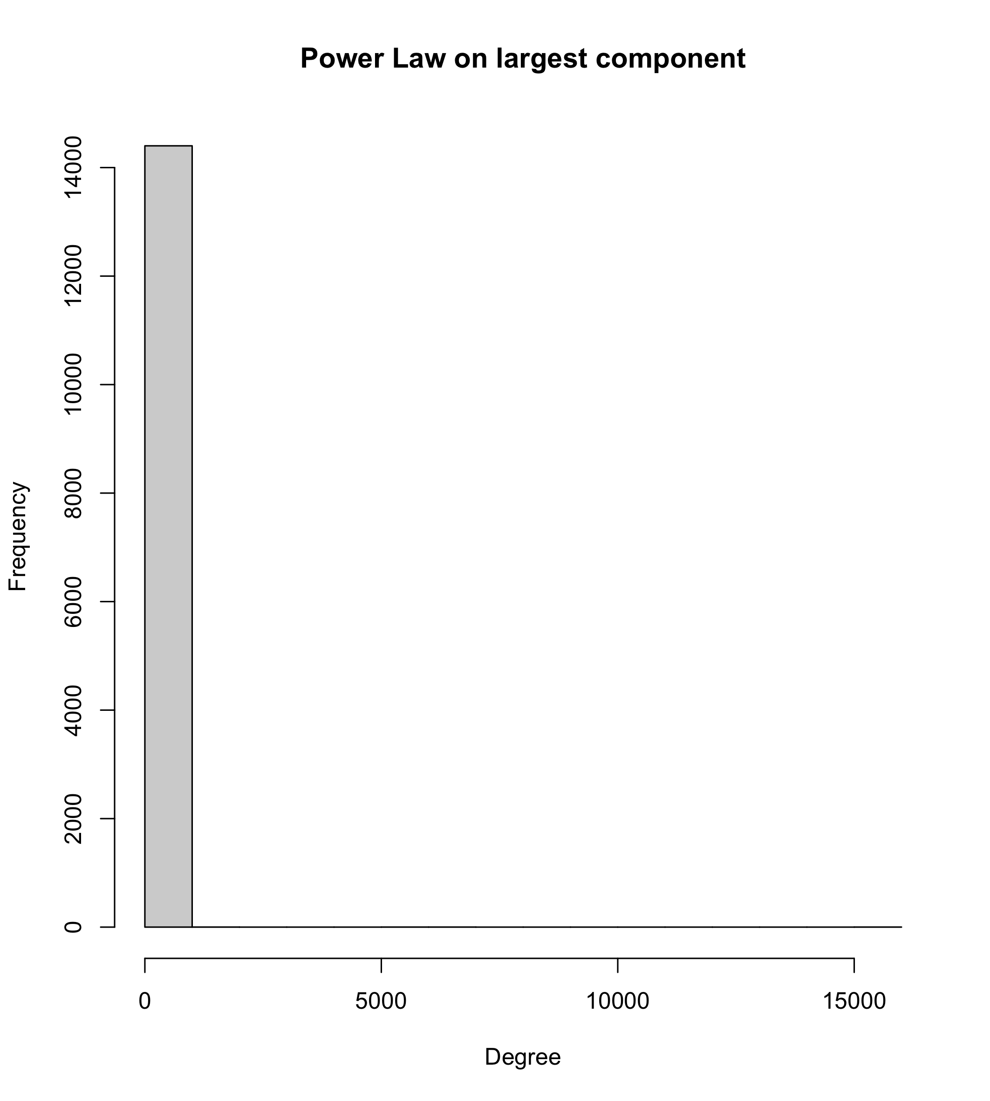
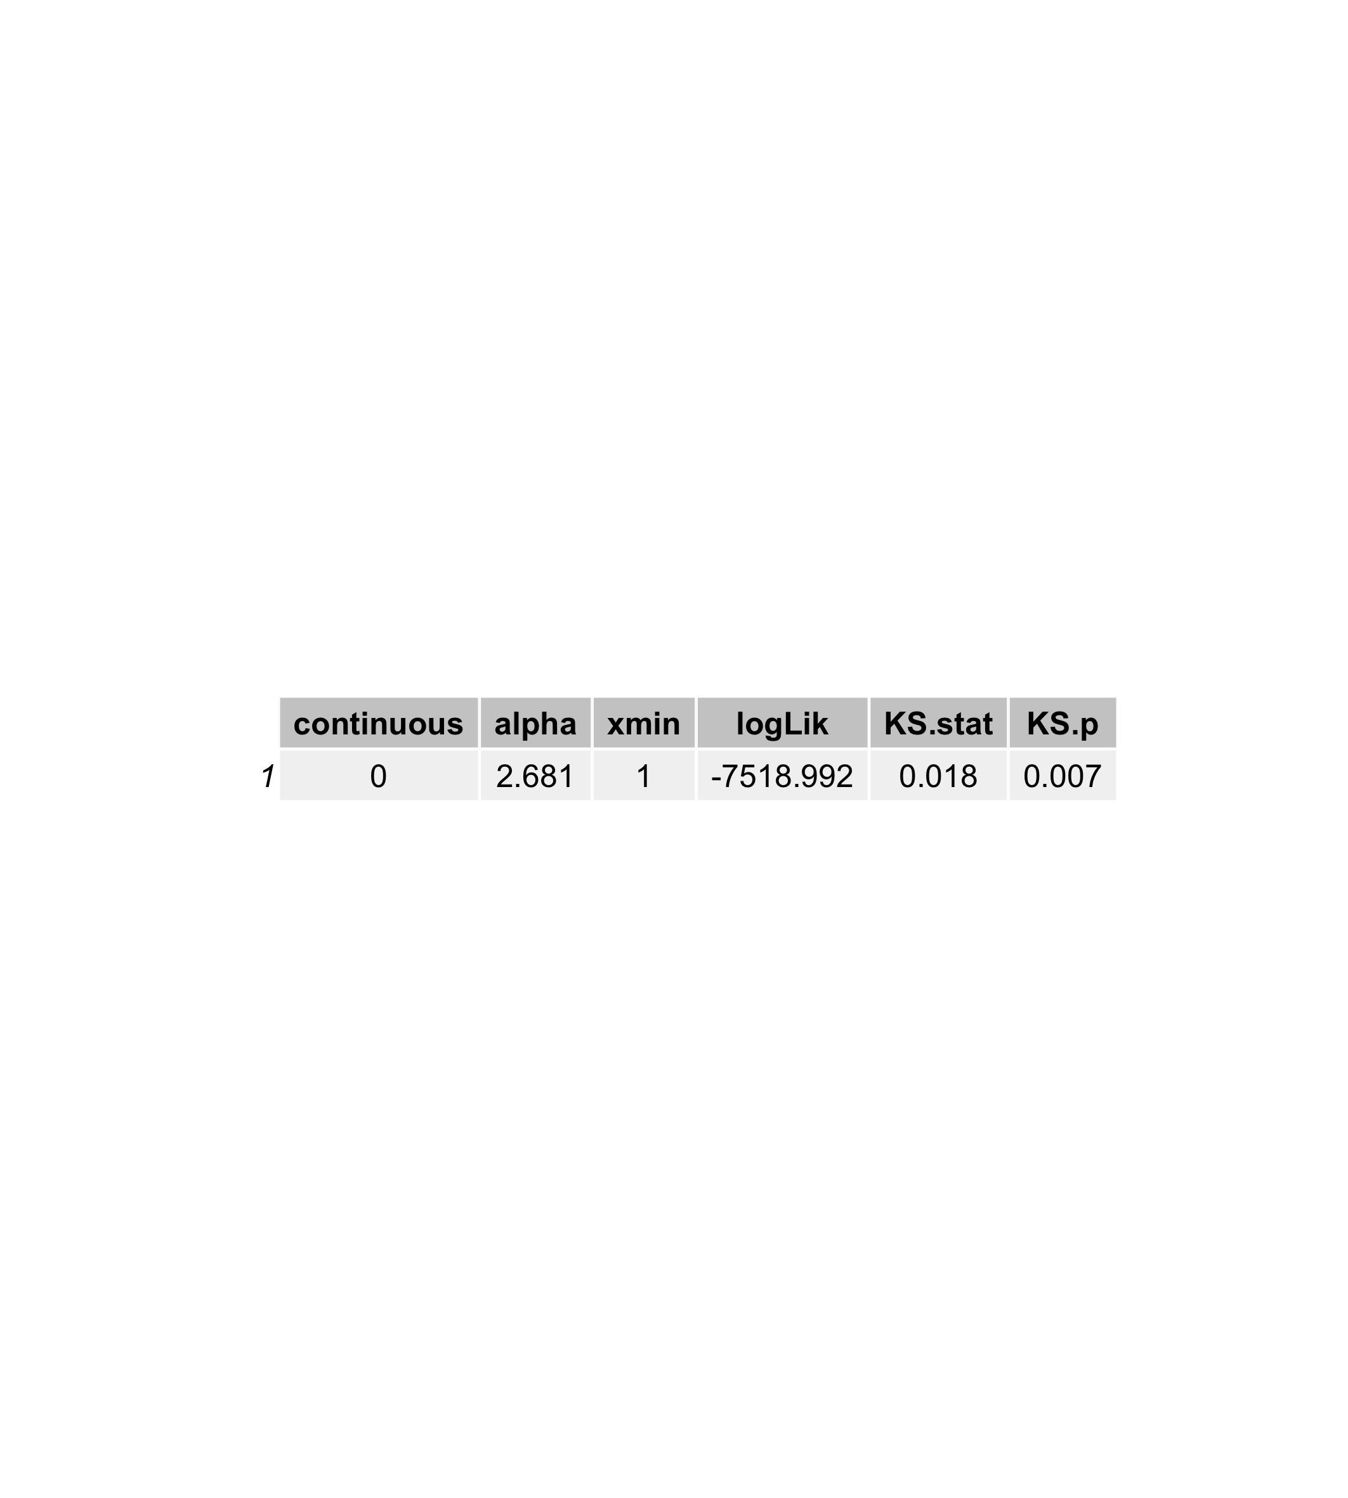
Power Law
Notes:
- Power law suggests everyone is at equality, which is a good thing otherwise a polarised interaction means some are doing "out of ordinary" activity.

Slide 16
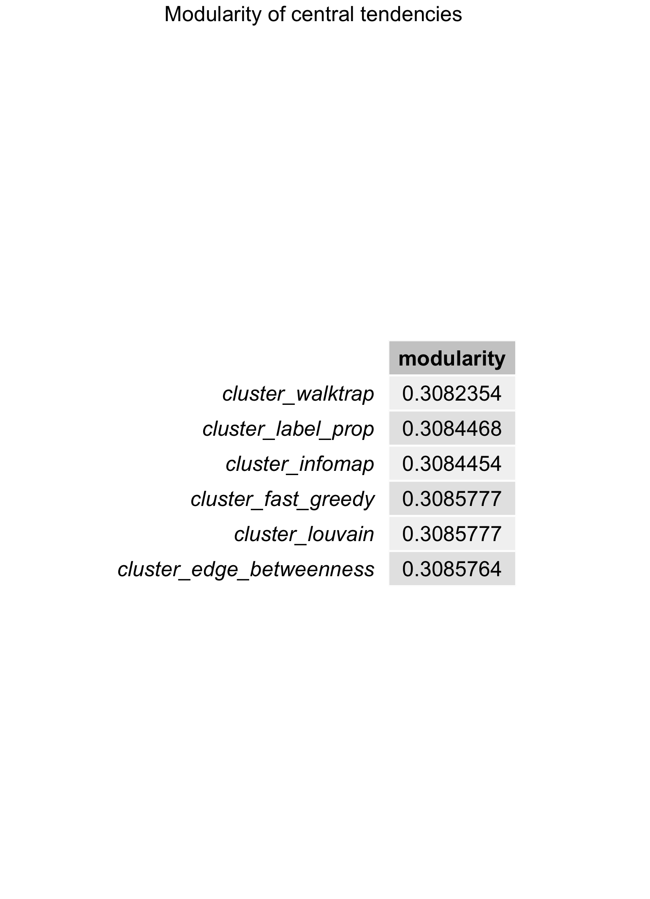
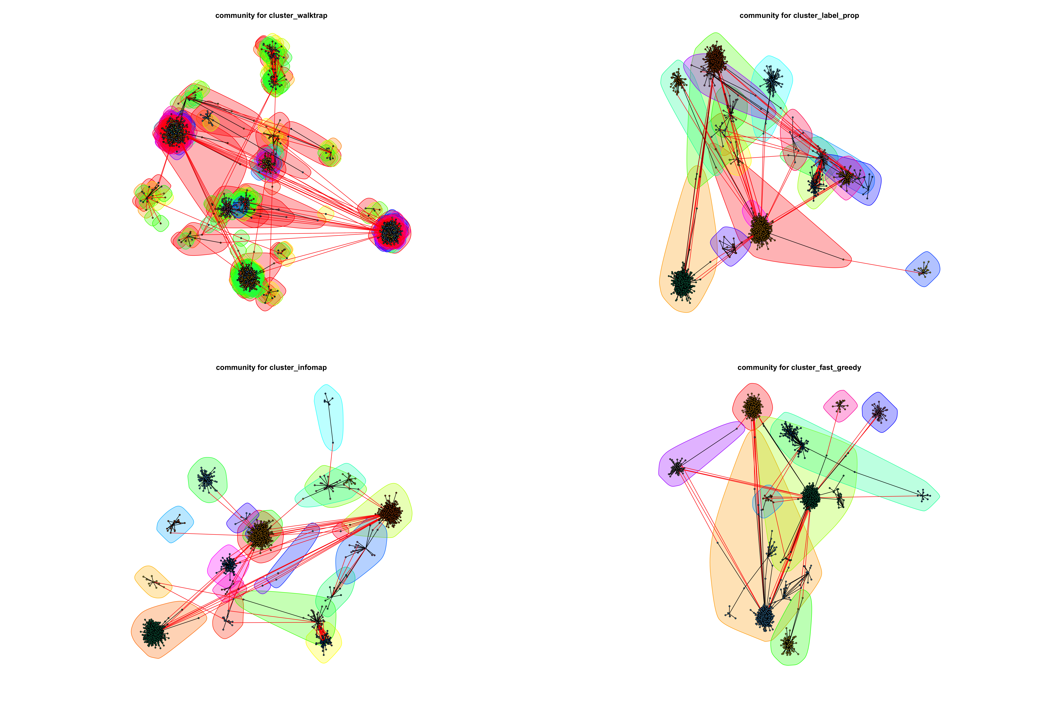
Modularity
Notes:
- Low modularity across multiple clustering algorithm shows similar validation that given the slice of the dataset, there is no suspicious transactions showing up yet.
- The community formation (centrality tendencies) of various exchanges are in fact overlapping in this given set of transactions. This situation may change very rapidly once dataset includes more transactions and longer chain of each transaction history.

Slide 17
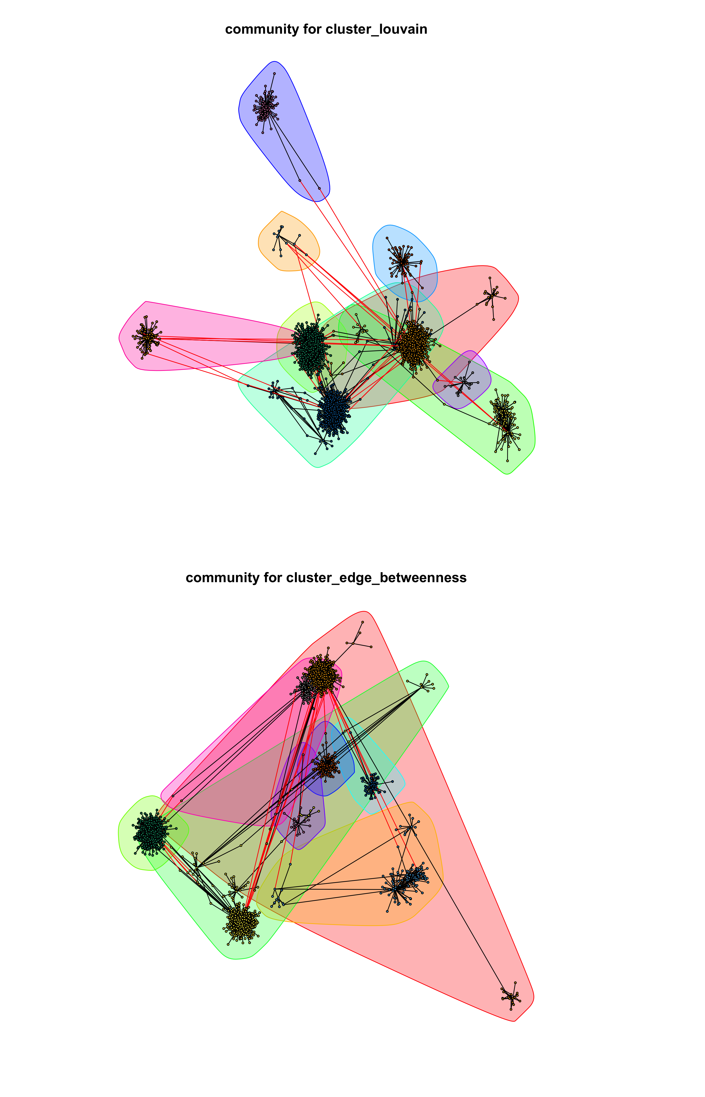
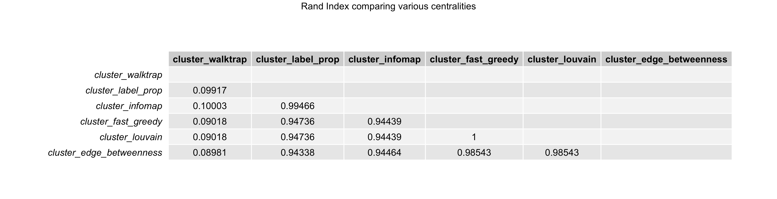
Centrality
Notes:
- Rand Index comparison shows agreement b/w the centrality measures except walktrap method, which in the 4-1.png (a) graph also indicating it.

Slide 18
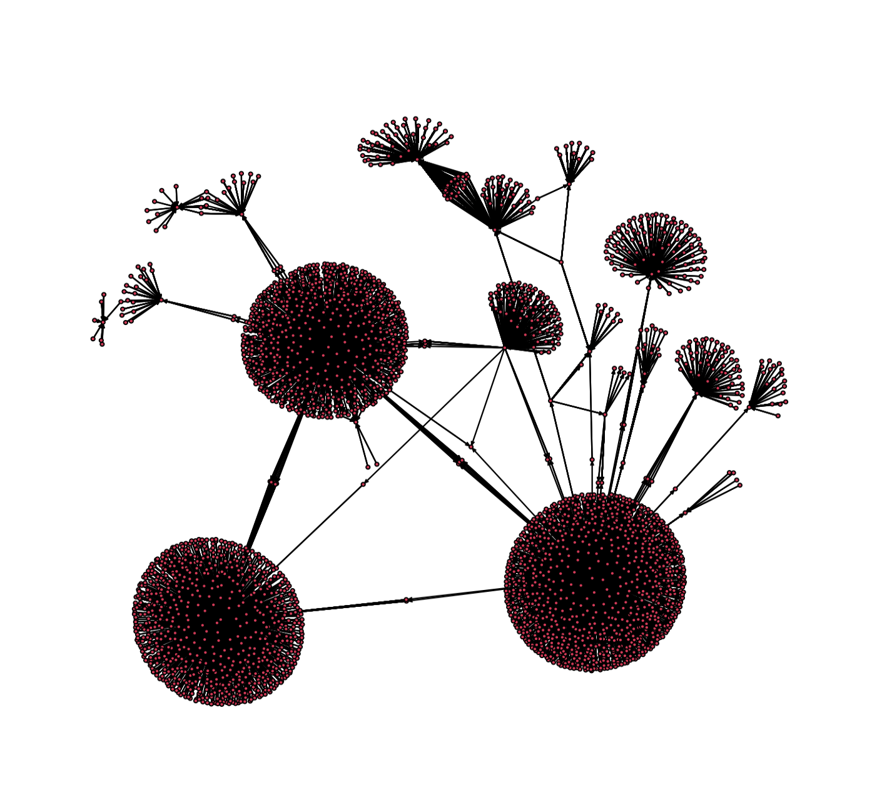
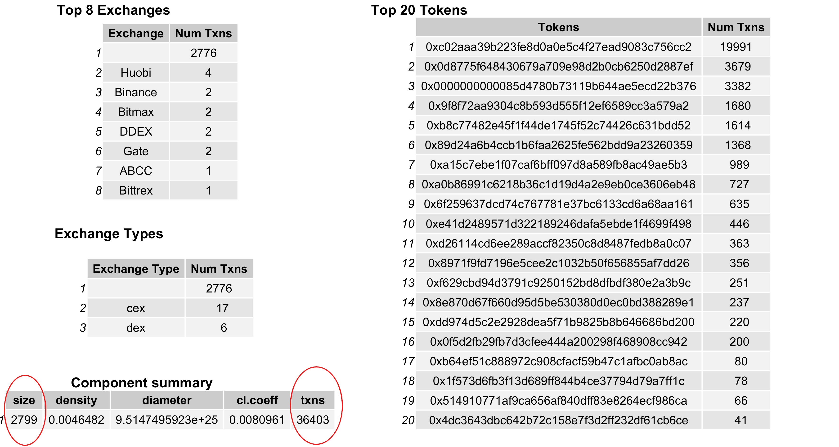
What does 50K edges’ largest component have?
Modeling
Notes:
Largest component is extracted and isolated from rest of the network for further modeling of various exchanges' traffic flow across multiple instruments (tokens).
1. What is inside largest component ?

Slide 19
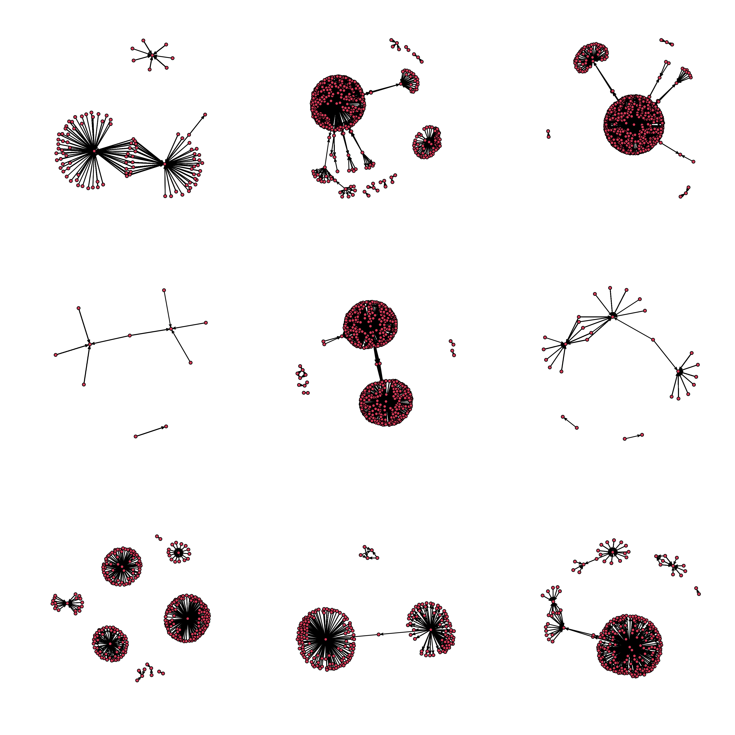
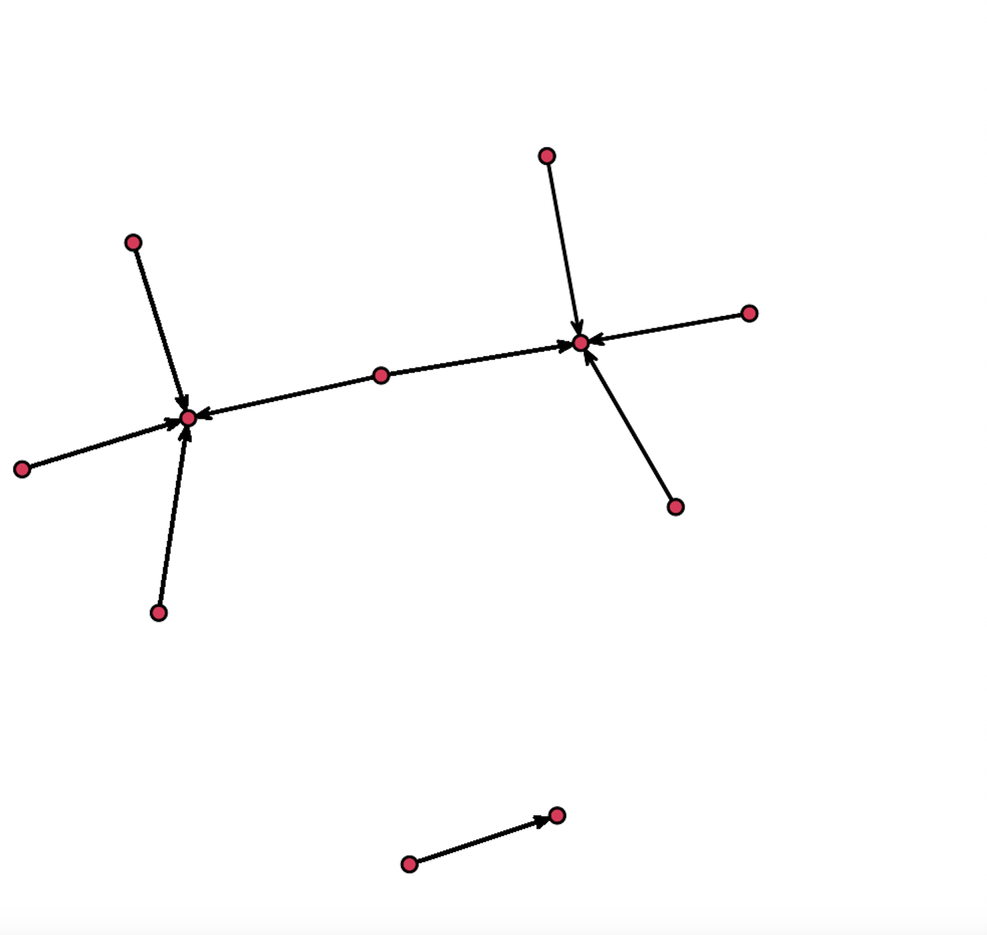
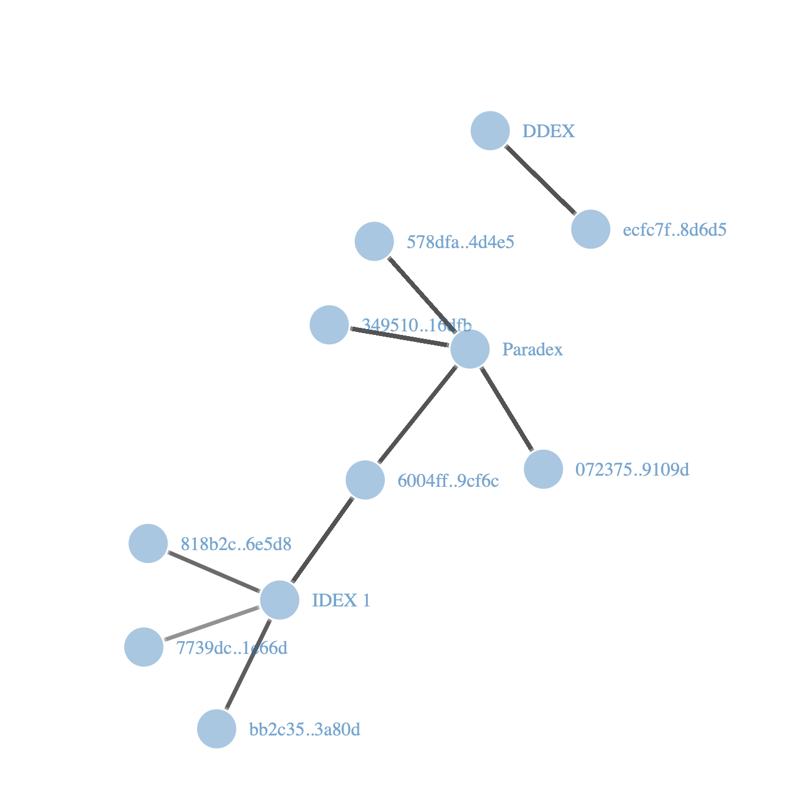
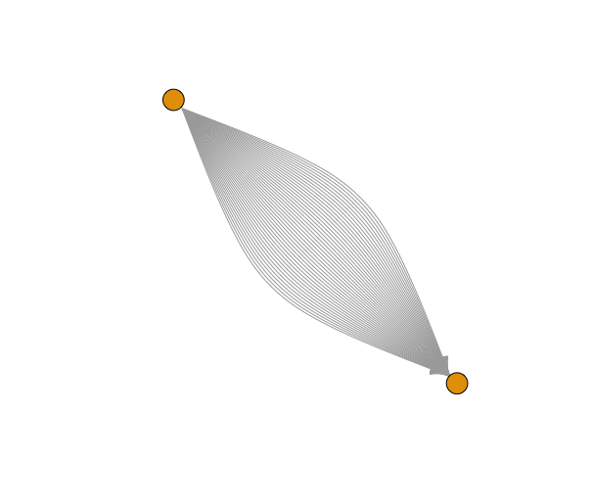
Top 9 Transaction:
Notes:
Each edge is having a heavy trades recorded
2.0 Top 9 individual transaction history
2.1 & 2.2 Closer inspection of 4th chart - degenerated communication
3. Actually its a heavy flow when node is isolated.

Slide 20
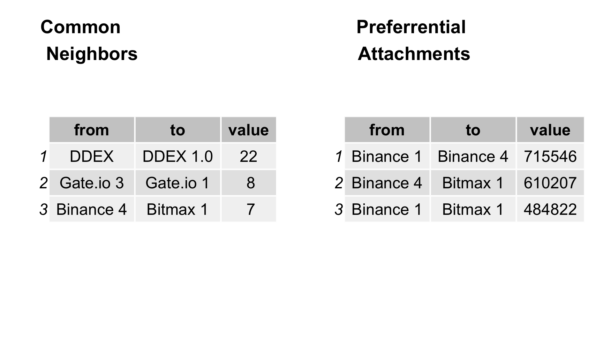
Future Friends
Notes:
Likelihood of becoming friends i.e., these exchanges as we saw previously showed affinity for newer transactions,
DDEX was our suspicious transaction because of its isolation from others, whereas Binance being large exchange, expected to have relatively more transactions and shows preferential trading.
However, due to latest investigation of April’2023, Binance might as well might elevate to a suspicious epicenter when analyzed with all 38Mill transactions.

Slide 21
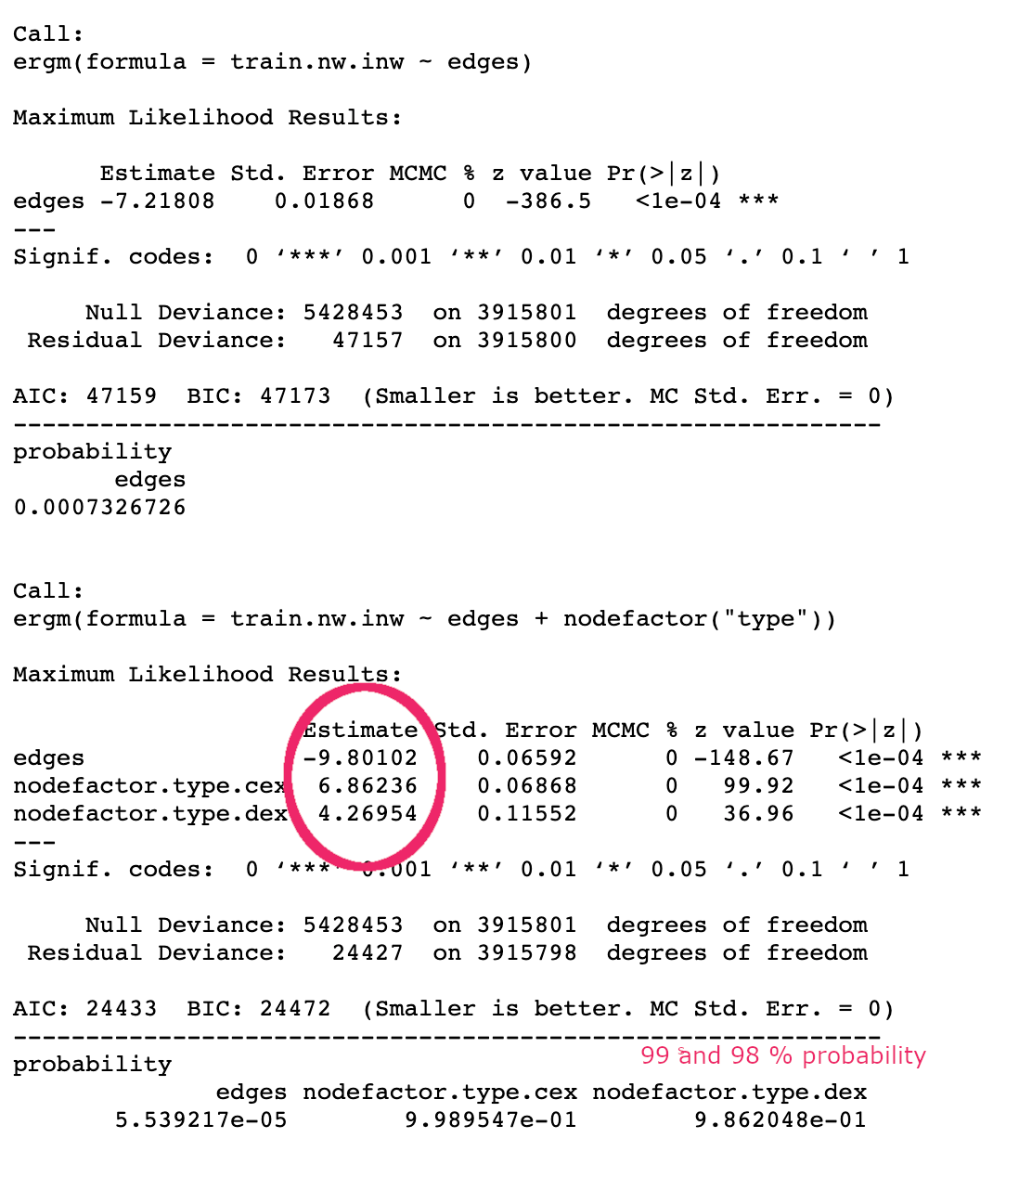
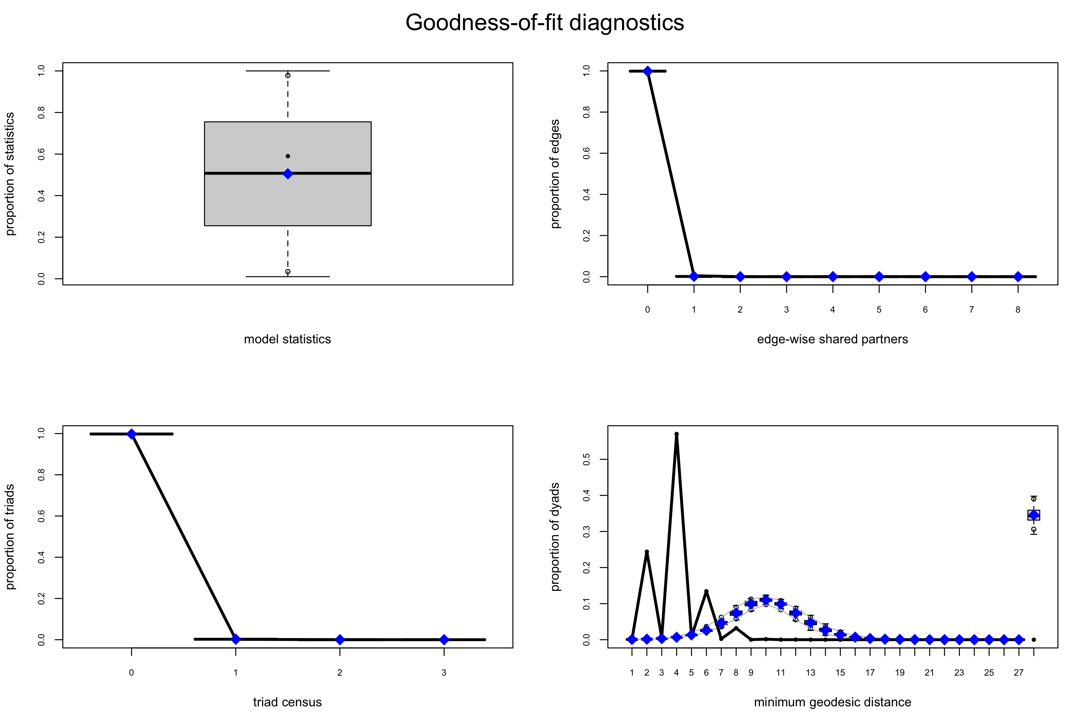
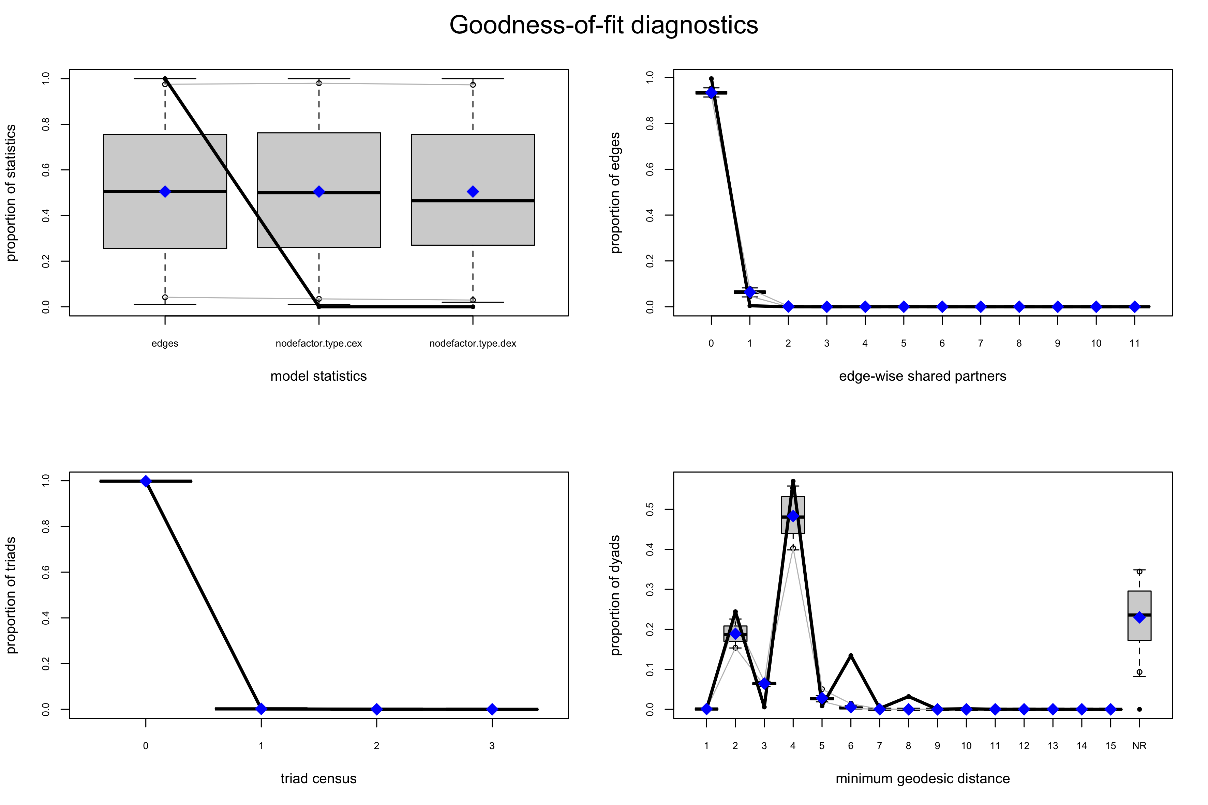
Base Model:
Notes:
Edge probability is equal to density of the network.
exchange type plays a significant role in classifying transactions however the model prediction is way off from the observations

Slide 22
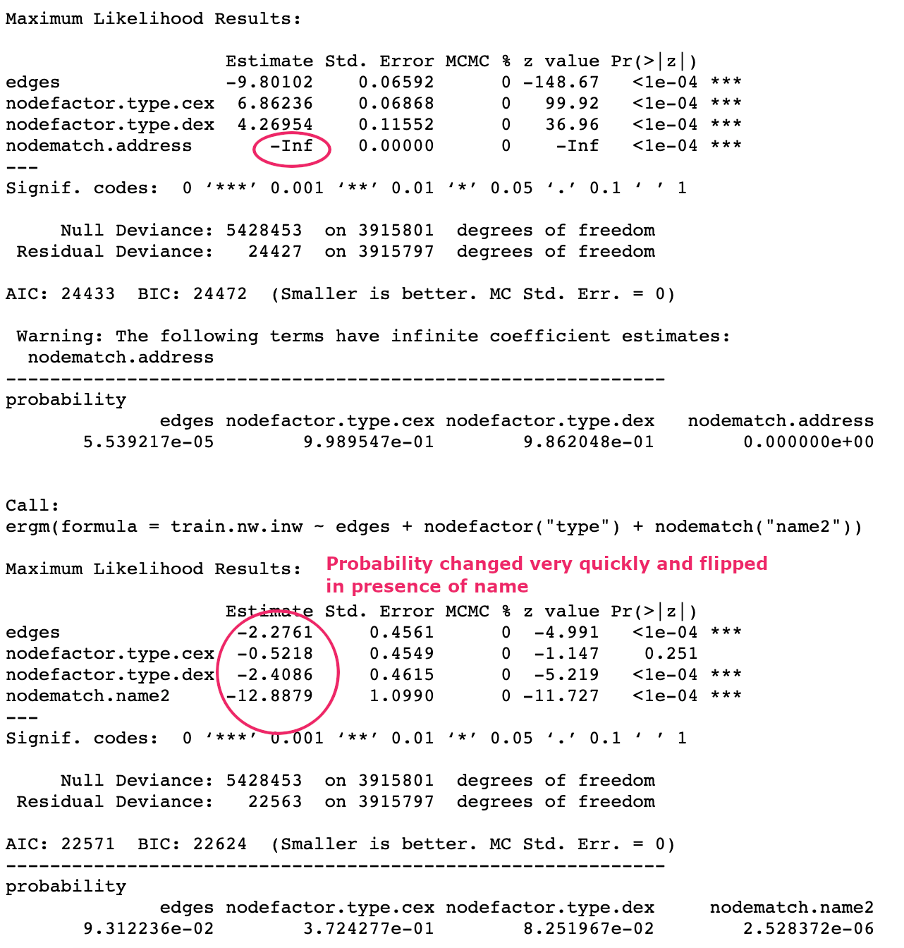
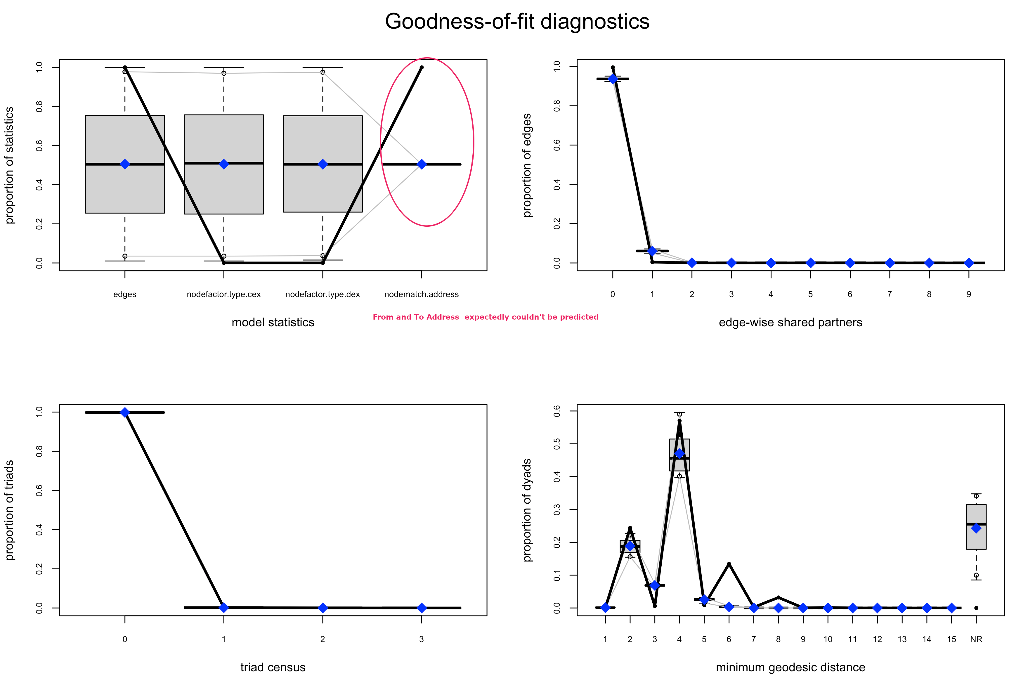
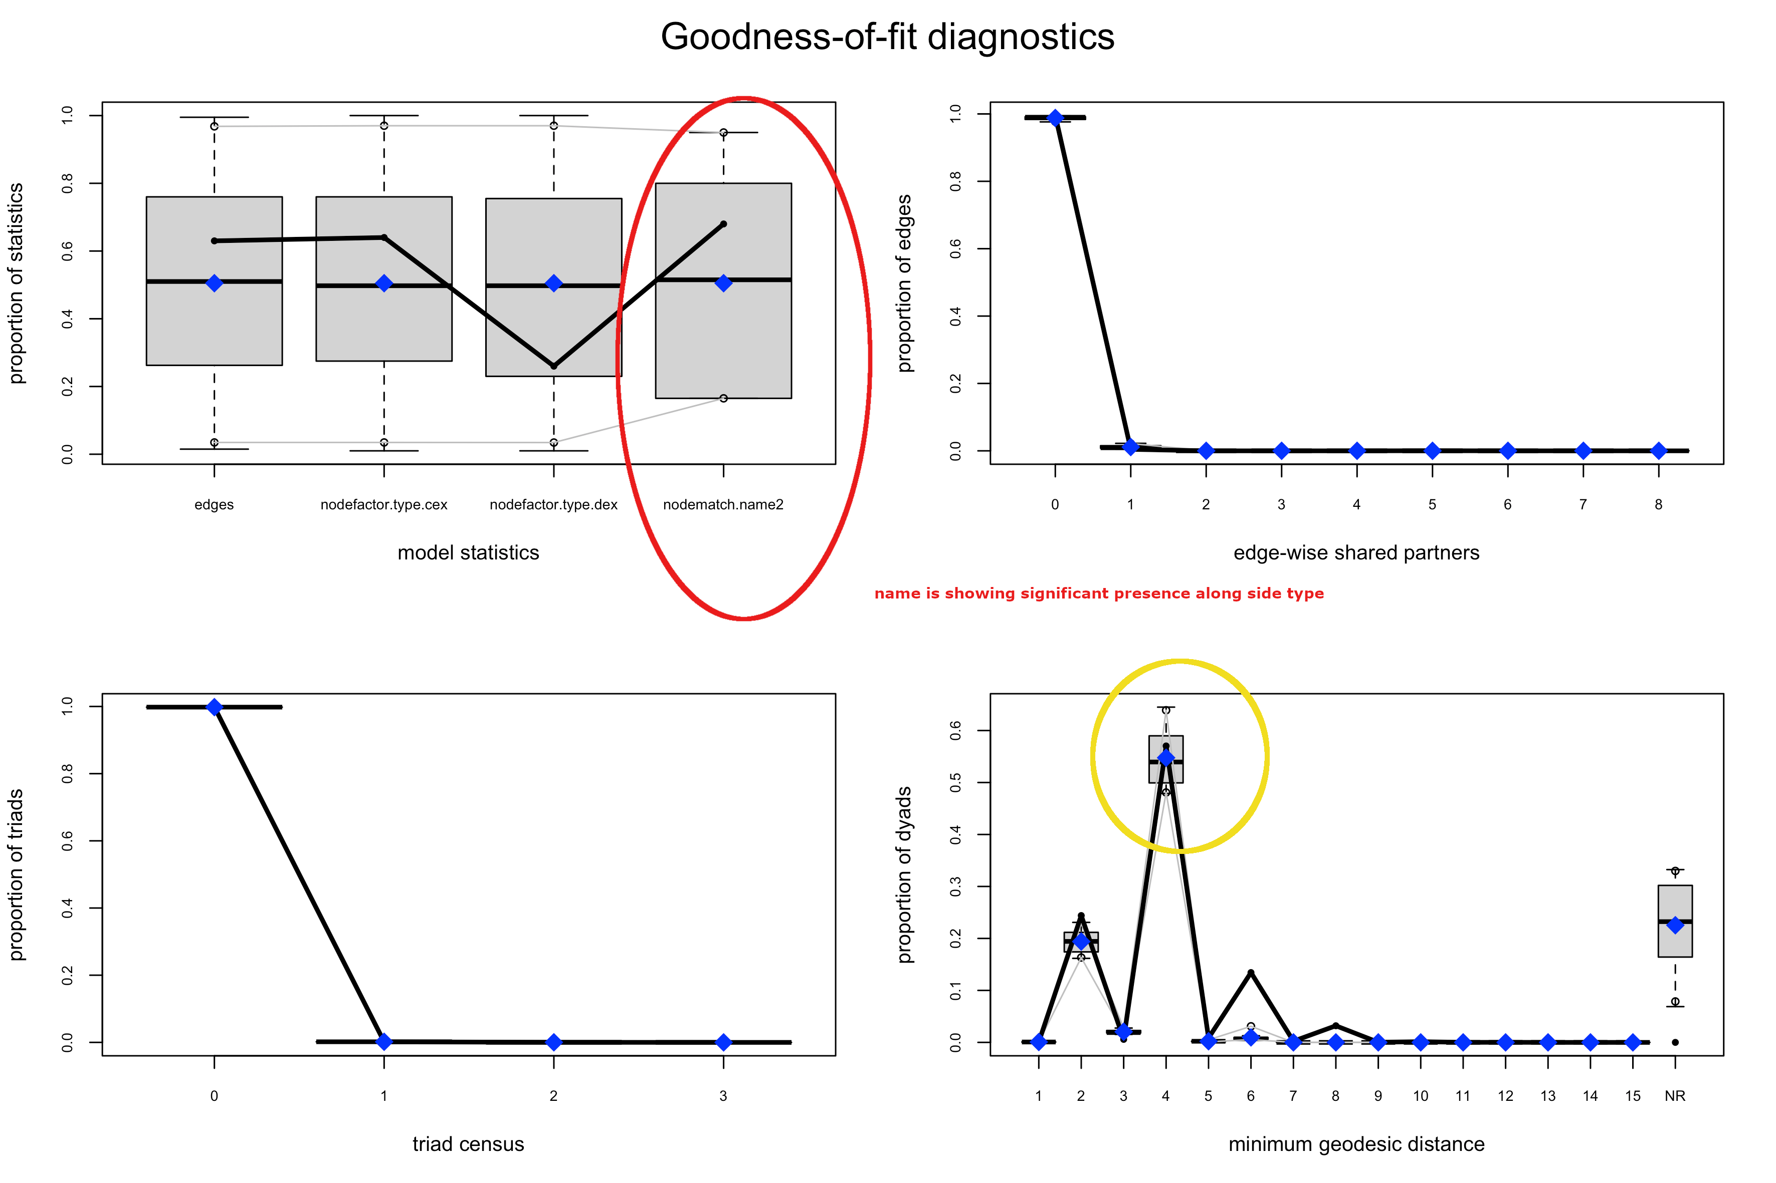
Base Model:
Notes:
name2 showing significance and address showing none.

Slide 23
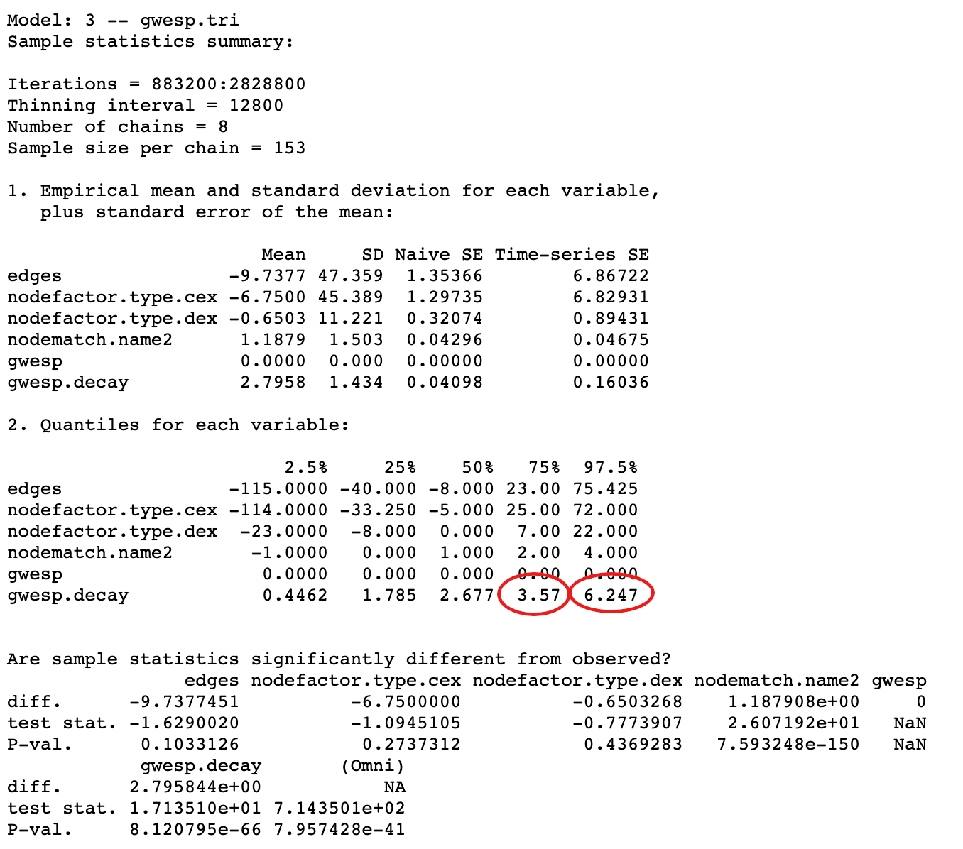
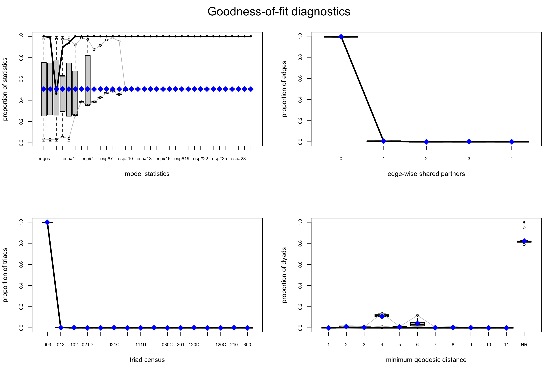
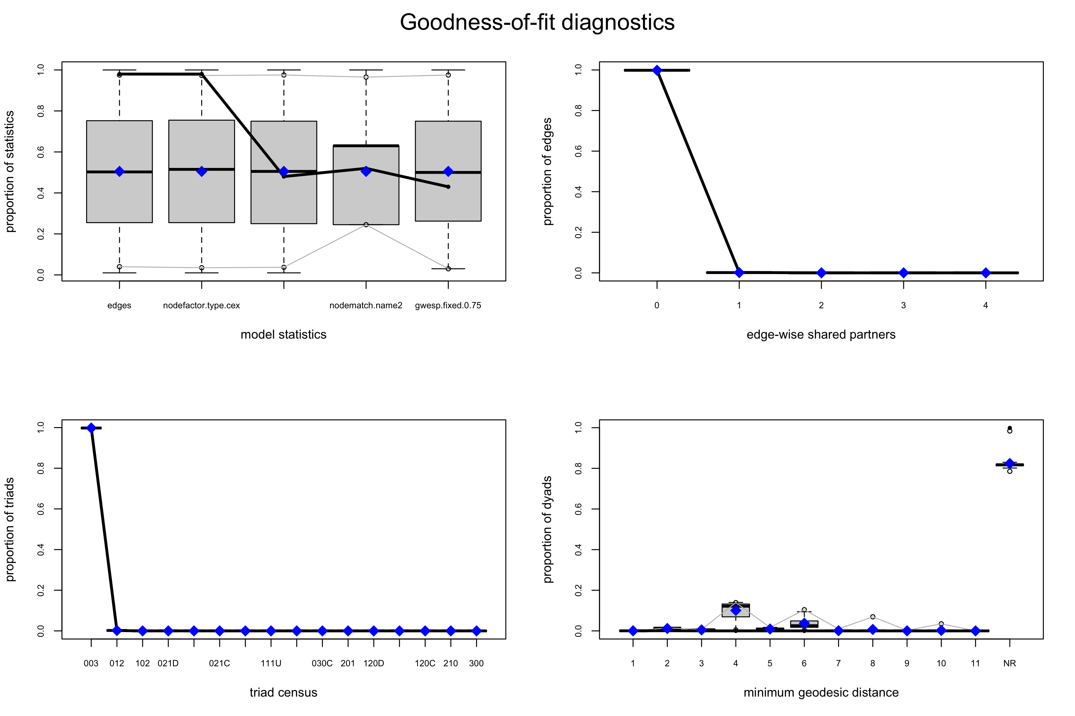
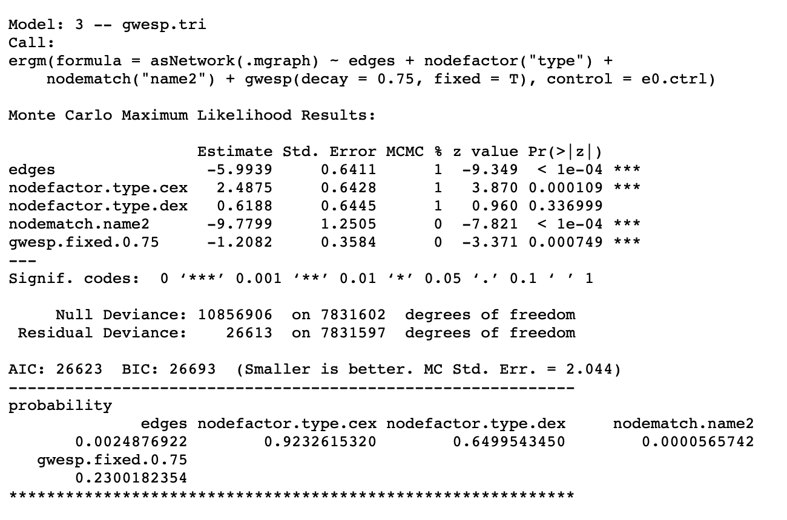
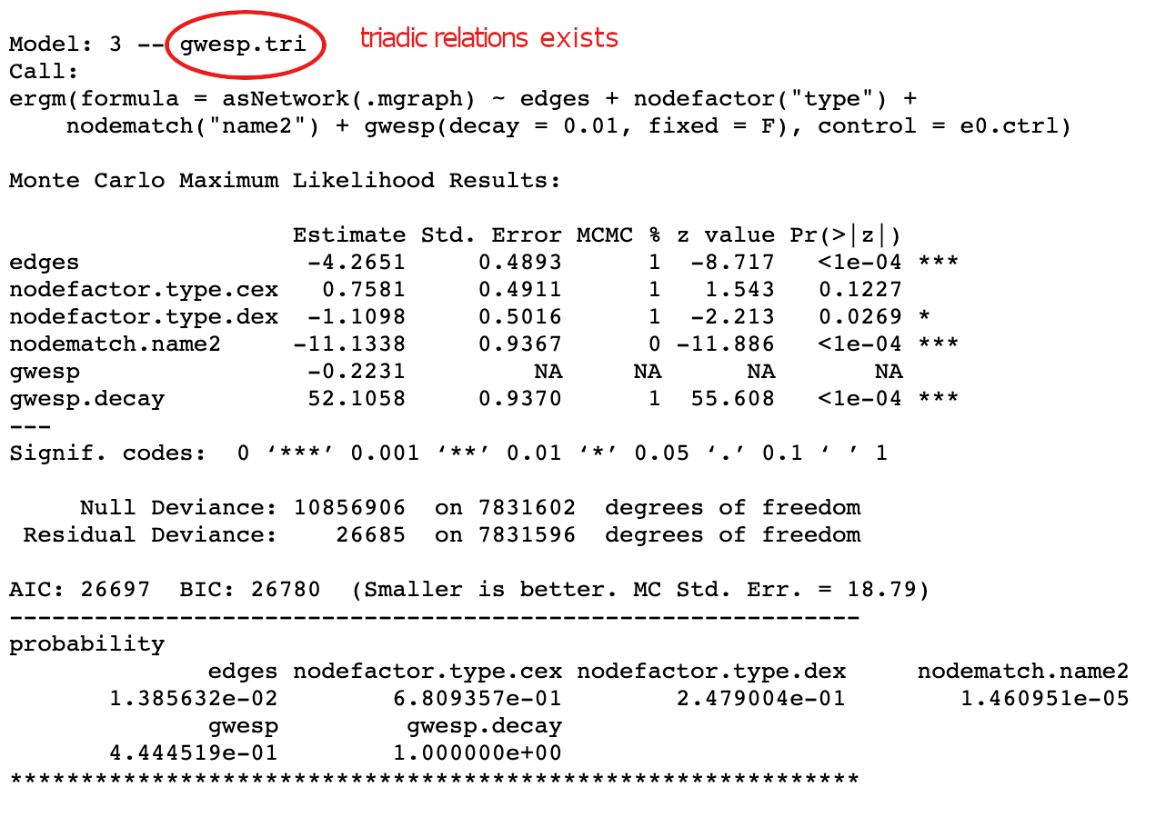
Model Improvement - 1:
Notes:
Tridiac Relations exists,
In similar lines we explored Geometrically Weighted Dyadic Shared Partners and concluded .75 decay is a good parameter.

Slide 24
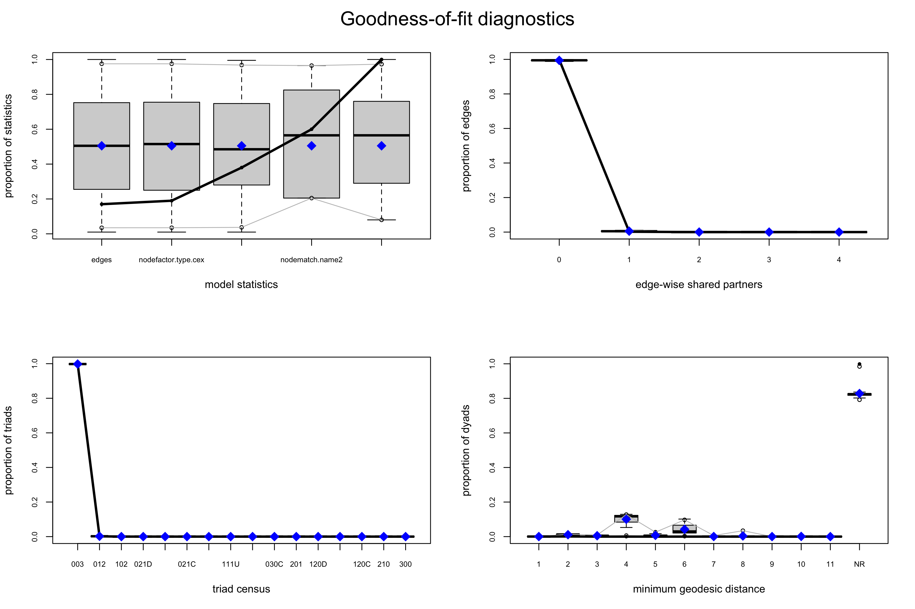
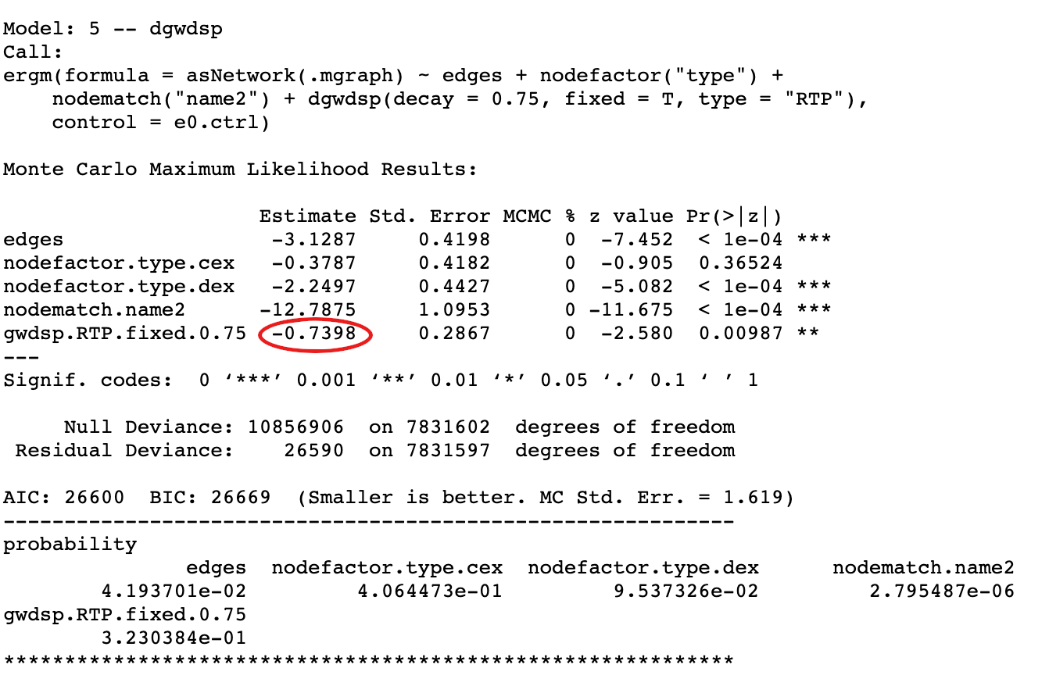
Model Improvement - 2:
Geometrically Weighted Dyadwise Shared Partner Distribution combination of GWESP and GWNSP
Reciprocated Two-path ("RTP"): vertex k is an RTP shared partner of ordered pair (i,j)(i,j) iff i↔k↔ji↔k↔j.
Notes:
pairwise triangles

Slide 25
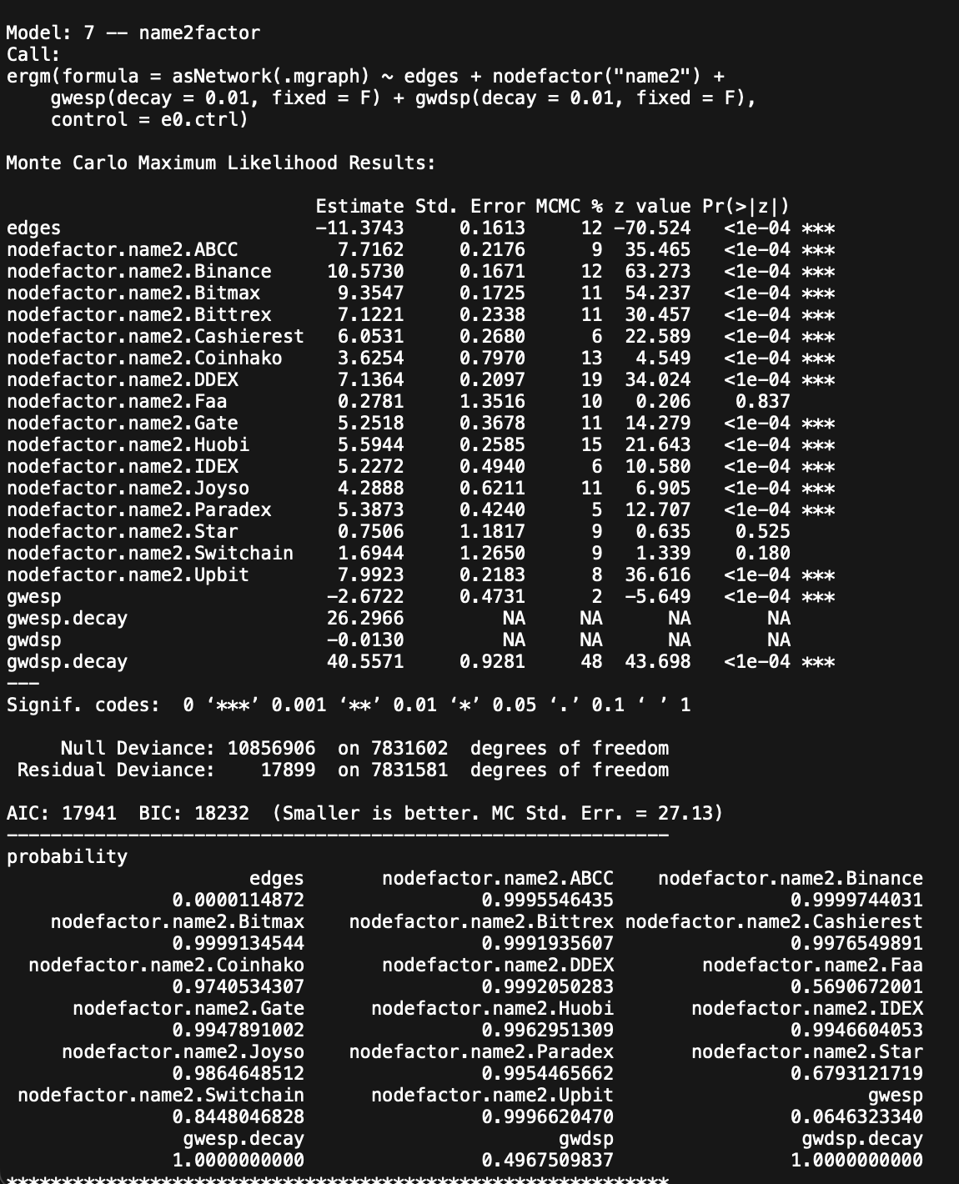
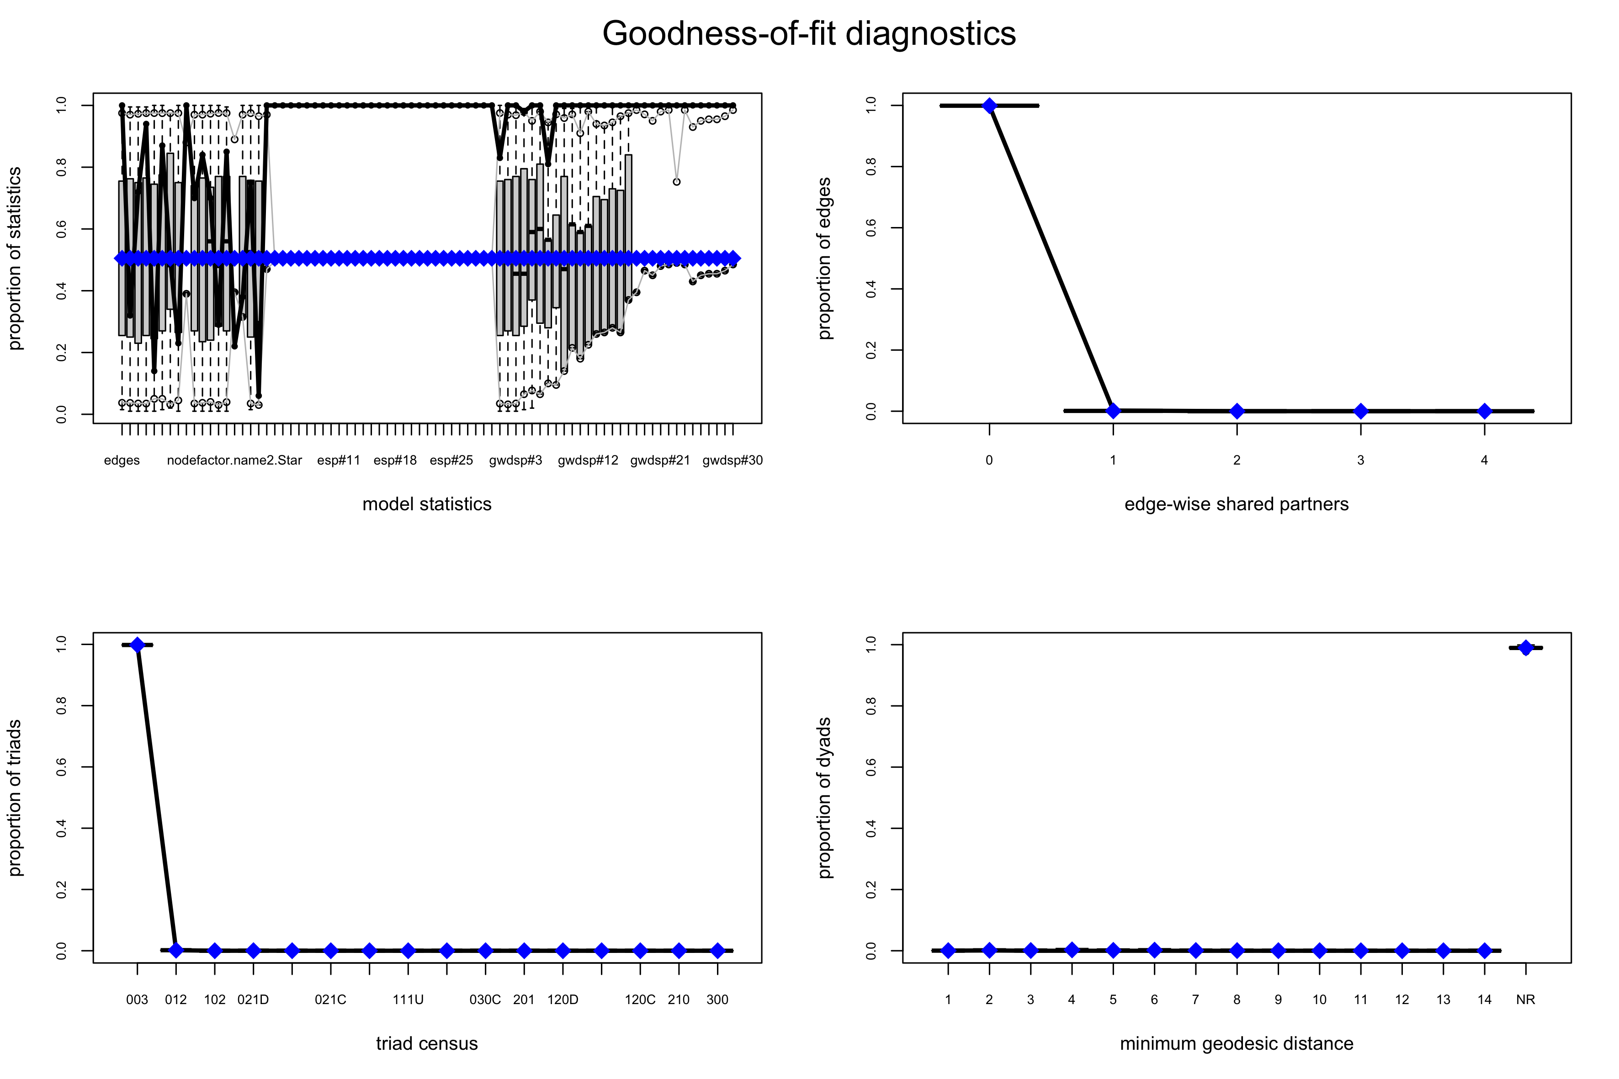
Model Improvement - 3:
Notes:
pairwise triangles

Slide 26
More ERGMs
Following constructs were explored but nothing significant came out but with more compute power can be explored on larger data set.
Transitive Ties
Cyclical Ties
Simmelian Ties
Threepath
Notes:
pairwise triangles

Slide 27
Future Enhancements
Egocentric Networks
Pick top few token addresses and use the entire chain as multi layered networks.
Valued ERGM
Edge weights are not considered so far.
Introduce Token address as edgematch like construct
R-GNN and R-GCN
Neural networks and Convolutional Networks for Graphs with relational preserving algorithms
Notes:
pairwise triangles

Slide 28
QUESTIONS?
THANK YOU

